Slide 1
Chemistry Mrs. Ashley HHS 2016-2017

Slide 2
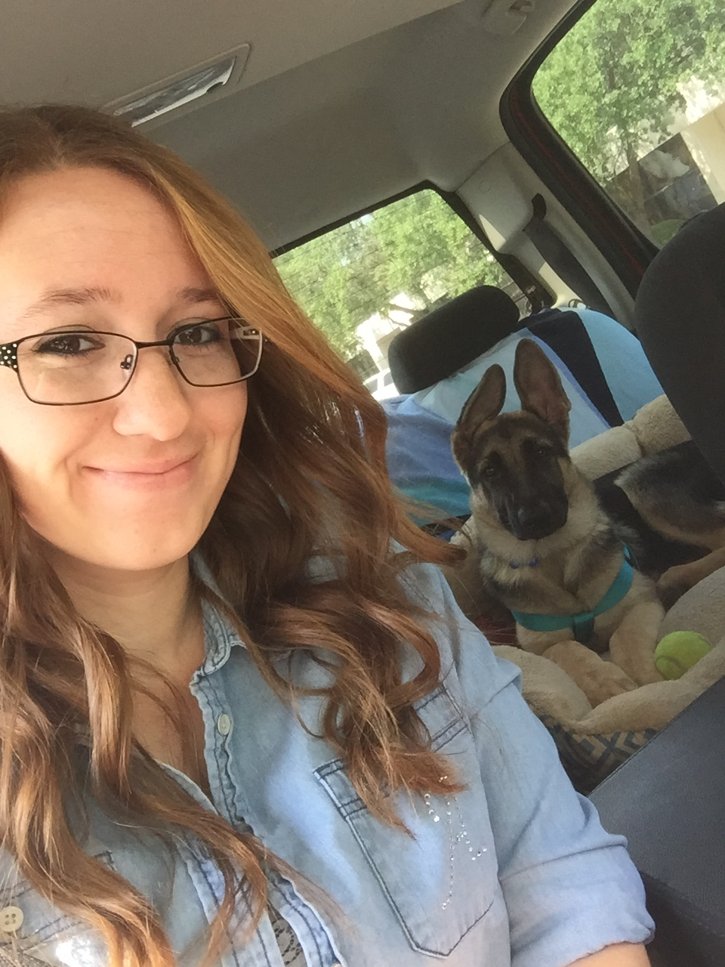
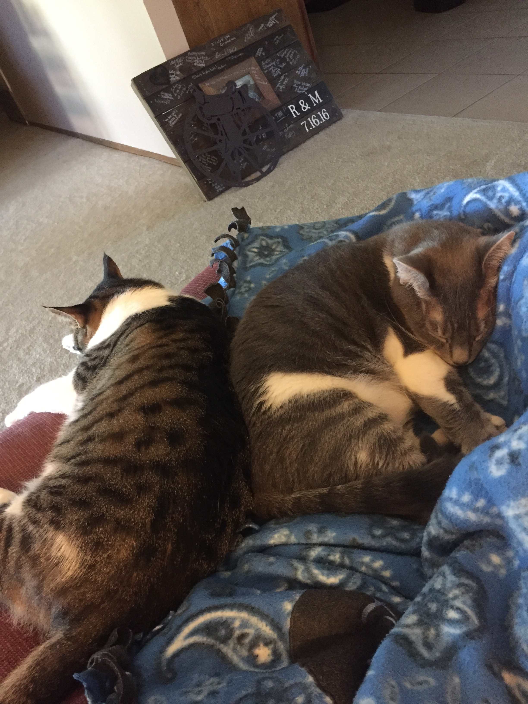
About Me

Slide 3
Class Materials:
2 Graphing Composition Notebooks
Pens (different ink colors may help you organize information)
Highlighters
Post-it Notes*
Tissues*
3X5 Note cards*
1 bottle of germex*
* optional

Slide 4
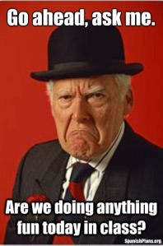
Routines & Lesson Plans
Class time will be a combination of direct instruction, independent practice, class discussion, labs, and group activities.
STEM Fridays (critical writing practice)
A good deal of studying must be completed OUTSIDE of class.
All lesson plans and study materials will be posted to my website which you can access at home or using the school computers.

Slide 5
Class Rules:
1. Responsibility

Slide 6
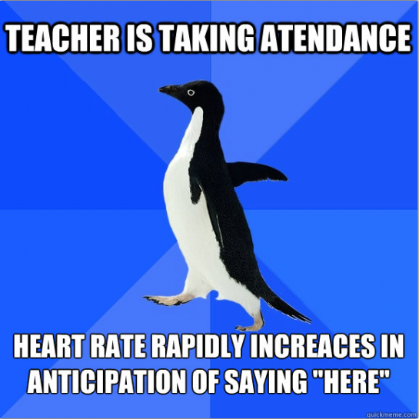
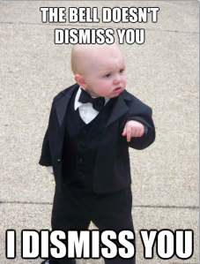
Class Rules:
2. Attendance

Slide 7
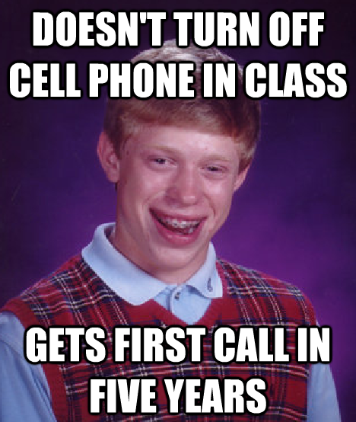
Class Rules:
3. Attention

Slide 8
Class Rules:
4. The 5 P’s

Slide 9
Class Moto:

Slide 10
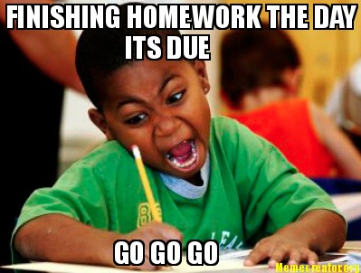
Homework
Designed to prepare students for class assignments and/or extend learning beyond the classroom.
Students should expect some out-of-class work in the form of larger projects or assignments to assess skills and knowledge over long-range time period. In addition, much of your reading will be done OUTSIDE of class.
Class time may or may not be provided to work on a given assignment. It is your responsibility to work in the classroom and outside of the classroom to complete assignments.

Slide 11
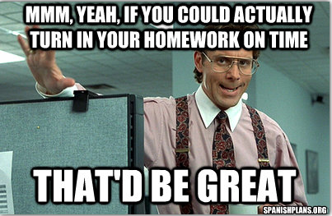
Late Work
Students must turn in a “Missing Work Log” stapled to the assignment.
10% of points deducted for each day late.
Parents contacted on major assignments OR when missing work exceeds three assignments.

Slide 12
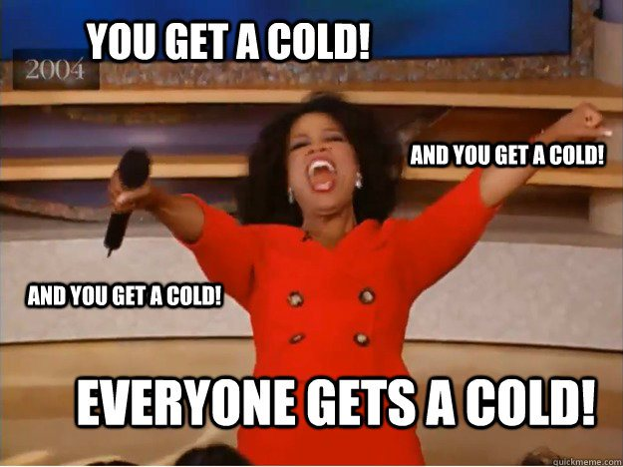
Make-up Work
Responsibility of the student to check the website & “Absent Folder” when absent.
Work should be made up within one day for each class day missed.
If you are going to be absent for a school event, or you know you will be absent beforehand, come discuss it with me and get your assignment before you leave.

Slide 13
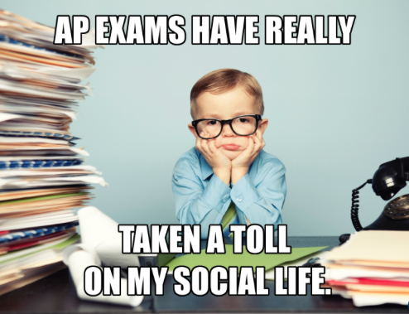
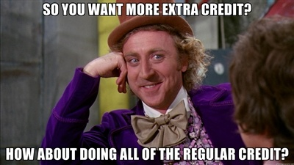
Assessment & Grading
Assessment will be a combination of participation, test/quizzes, projects, presentations, labs, and writing assignments.
Grades calculated using percentages listed in the syllabus.
All grades will be posted as they are updated.
Late grades will be posted whenever I get the time to grade them. Do not expect them to be graded immediately!

Slide 14
Stay in Touch
Your class codes are posted on the website as well as printed and posted in the classroom

Slide 15
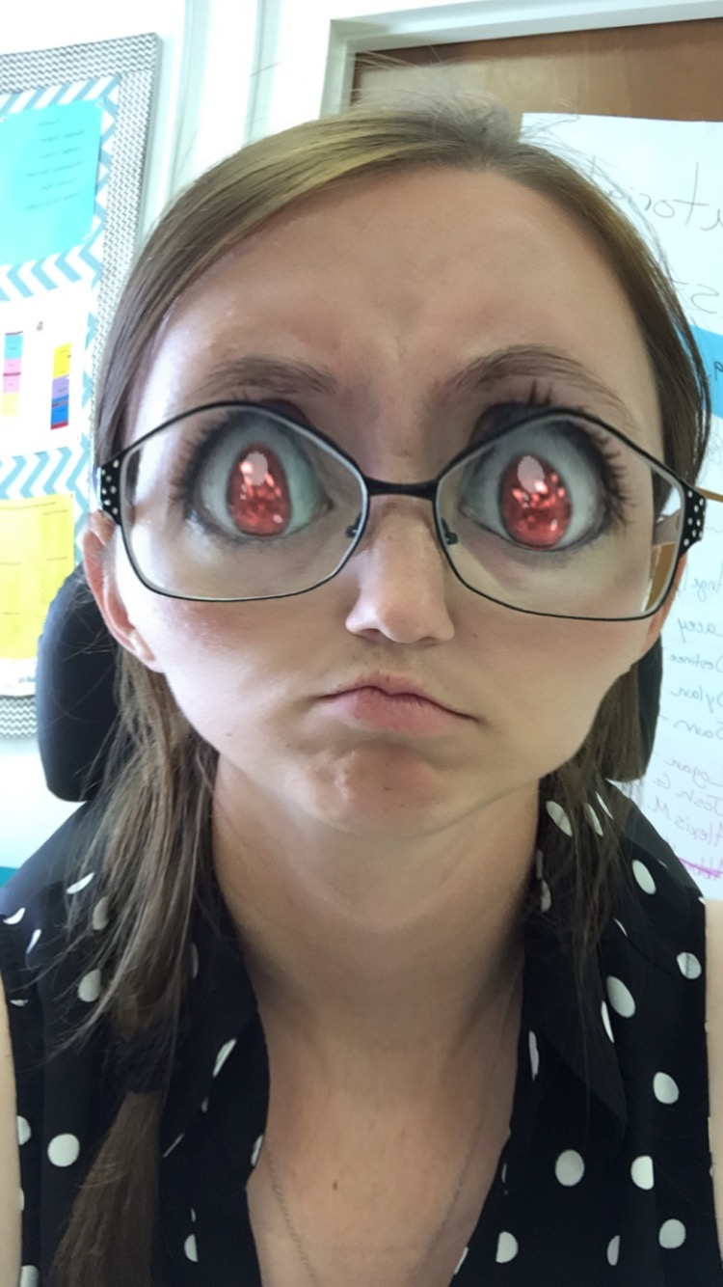
As long as you work hard and do what you’re supposed to be doing in my class we will have a great year!
If you aren’t doing your work….
Let’s just say you wouldn’t like me when I’m grading piles of late work.

