Slide 1
More Complex Circuits
Chapter 9 Section 3

Slide 2
Let’s Review
What did you learn yesterday?
What is electric current?
What is the triangle for Ohm’s Law?
What is a resistor? What does it do?

Slide 3
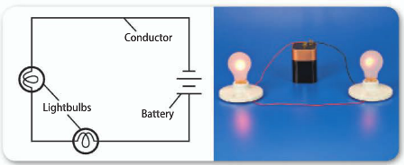
Series Circuits
Most real circuits are not simple circuits with one power source, one device, and one path for the current like the ones we saw in the last section
One kind of circuit is called a series circuit
A series circuit is an electric circuit with only one branch
Because parts of a series are wired one after another, the amount of current is the same through every part

Slide 4
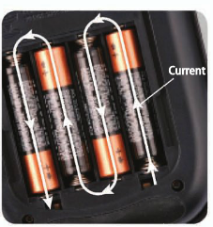
Open Circuits
In an open circuit, when any part of the series is disconnected, there is no current through the circuit.
If you remove one battery from a calculator then you have now caused an open circuit

Slide 5
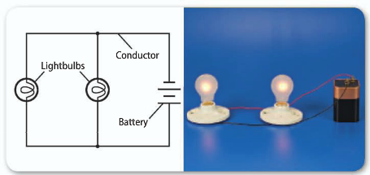
Parallel Circuits
Parallel circuits contain two or more branches for a current
Devices on each branch can be turned on or off separately
There can be a current through both or either of the branches
Because all branches connect the same two points of the circuit, the voltage difference is the same in each branch
Because of Ohm’s Law, the current is greater through the branches with lower resistance

Slide 6
Household Circuits
The voltage difference in most branches is 120 V.

Slide 7
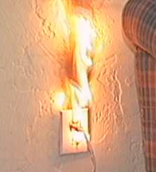
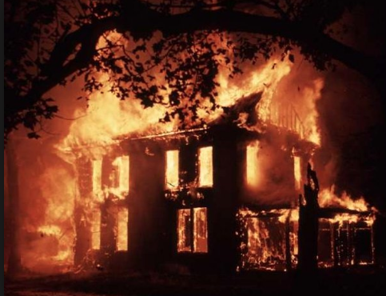
Safety Devices
In a home, many appliances draw current from the same circuit
If more appliances are connected, then more current will run through the wires
As the amount of current increases, so does the amount of heat produced by the wires
To protect against overheating of wires, all household circuits should contain either a fuse or circuit breaker

Slide 8
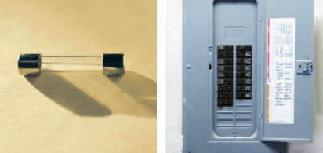
Safety Devices cont.
Fuses
An electrical fuse contains a small piece of metal that melts if the current becomes too high
When this piece of metal melts, is causes a break in the circuit, stopping the current
Circuit Breakers
In a circuit breaker, a switch is automatically flipped when the circuit becomes too great
Flipping the switch opens the circuit and stops the current

Slide 9
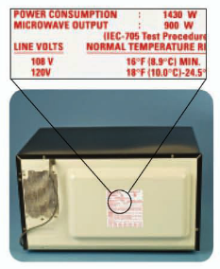
Electrical Power and Energy
Electrical Power: the rate at which electrical energy is converted to another form of energy
Many appliances that use electrical power are labeled with a power rating

Slide 10
Calculate Electrical Power
Electrical power can be calculated using the following equation:

Slide 11
Electrical Power Calculation
Solve for electrical power
The current in a clothes dryer is 15A when it is plugged into a 240V outlet. What is the power of the clothes dryer?

Slide 12
Electrical Energy
Electric companies provide the electrical energy that you can then transform into other forms, such as mechanical or thermal energy
The electrical energy that companies provide can be calculated form the following equation:

Slide 13
Calculating Electrical Energy
Solve for electrical energy
A microwave oven with a power rating of 1,200W is used for 0.25h. How much electrical energy did the power company provide for the microwave?

Slide 14
OTB Practice Activity
A toaster oven is plugged into an outlet where the voltage difference is 120V. How much power does the toaster oven use if the current in the oven is 10A?
A video-disc player that is not playing still uses 6.0W of power. What is the current into the player if it is plugged into a standard 120V outlet?

Slide 15
OTB Practice Activity
A flashlight bulb uses 2.4 W of power when the current in the bulb is 0.8A. What is the voltage difference supplied by the batteries?
A fridge operates on avg for 10.0h a day. If the power rating of the fridge is 700W, how much electrical energy does the fridge use in one day?

Slide 16
OTB Practice Activity
A TV with a power rating of 200W uses 0.8 kWh of electrical energy in one day. For how many hours was the TV on during this day?
A hair dryer has a power of 1,200W. How much electrical energy does the hair dryer use in 3 minutes?

Slide 17
Assignment
Work on the 6.3 Assignment Worksheet

Slide 18
Wrap Up
What is the difference between series and parallel circuits?
What are two things used in houses to protect them from fires caused by electrical circuit malfunctions?
What is electrical power?

