Slide 1
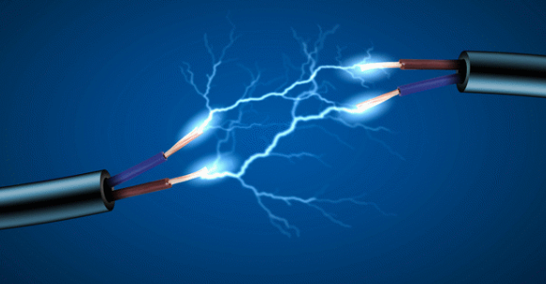
Electric Current
Chapter 9 Section 2

Slide 2
Let’s Review: Electric Charge
What are the two types of electric charge we saw in Section 1?
What does the Law of Conservation of Charge state?
What is an electric field?
What is the difference between charging by contact and charging by induction?

Slide 3
Electric Current
Electric Current: the net movement of electric charges in a single direction
Electric Current is measured in amperes (A)
1 A = 1 coulomb of electric charge flowing past a point every second

Slide 4
Electric Current cont.
In a metal wire without electric current, electrons are in constant random motion. This means there is no net movement of electrons in one direction.
However, when there is an electric current in the wire, electrons continue their random movements but they also drift in the direction of the current

Slide 5
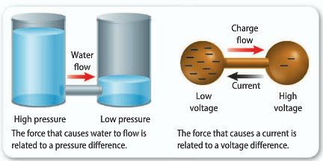
Voltage Difference
Electric current moves in a way similar to water in a pipe
Electric current flows from a higher voltage to a lower voltage
A voltage difference is related to the force that causes the charges to flow.
Voltage difference is measured in Volts (V)

Slide 6
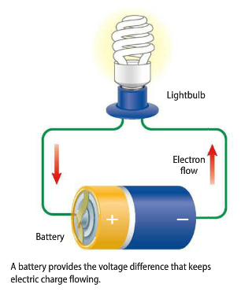
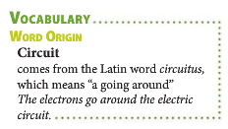
Electric Circuits
An electric circuit is a closed path that electric currents follows
If the battery, light bulb, or one of the wires was removed from the circuit the pathway is broken and thus there will be no current

Slide 7
Current and Electron Flow
Contrary to popular belief, in almost all circuits it is the negatively charged electrons that move through the circuit not a positive charge
Because current is in the direction of positive charge flow, the flow of electrons and the current are in opposite directions
Electric Current flows from higher voltage to lower voltage
Electrons in a circuit flow from lower voltage to higher voltage

Slide 8
Batteries
To keep electric charges continually flowing in a circuit, a voltage difference needs to be maintained in the circuit
Power supplies, such as batteries, can provide the voltage difference
There are three main types of batteries we will discuss in this section
Wet Cell
Dry Cell
Lead-Acid

Slide 9
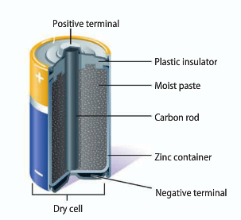
Dry- Cell Batteries
You are probably most familiar with dry-cell batteries
The cylindrical batteries that you see most often (AA, AAA, etc) are examples of dry cells
The voltage difference between the two terminals (one positive and one negative) causes a current through a closed circuit

Slide 10
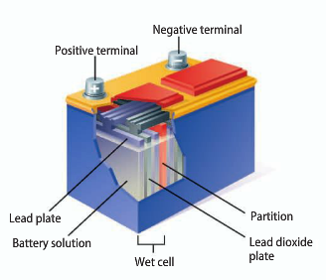
Wet- Cell Batteries
A wet cell battery contains two connected plates made of different metals or metallic compounds in an electrolyte
Unlike a dry cell, the electrolyte in a wet cell is a conducting liquid solution.
The most common type of wet-cell battery is a car battery

Slide 11
Lead-Acid Batteries
Most car batteries are lead-acid batteries, like the wet cell we just viewed
A lead-acid battery contains a series of six wet cells composed of lead and lead dioxide plates in a sulfuric acid solution
The chemical reaction in each cell provides a voltage difference of about 2V, giving a total voltage difference of 12V.

Slide 12
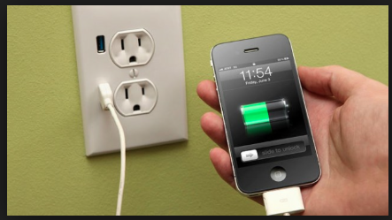
Electrical Outlets
A voltage difference is also provided at electrical outlets, such as a wall socket
This voltage difference is usually higher than the difference provided by batteries
The avg voltage difference across the two holes in a wall socket is usually 120V
Certain devices, like washers/dryers, plug into special 240V electrical outlets

Slide 13
Currents and Resistance
Resistance: the tendency for a material to resist the flow of electrons and to convert electrical energy into other forms of energy (such as thermal energy)
Resistance is measured in Ohms (Ω)
This is why cell phones can get hot during a long telephone call.

Slide 14
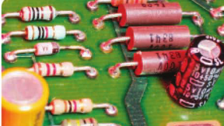
Resistance
If you look inside a computer, phone, etc you might find striped objects like those in the picture below.
These objects are called resistors, and they are designed to resist the flow of electrons
Electrical engineers use resistors to reduce the current through all or part of a circuit and are used to help protect more delicate electronic components that can melt or break if too much current is sent through them

Slide 15
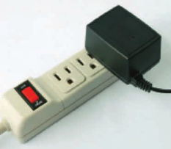
Alternating Current & Direct Current
The AC in AC/DC currents stands for alternating current
AC is the kind of current from household electrical outlets
The DC in AC/DC stand for direct current
Unlike alternating current, direct current never changes direction
DC current is used to charge batteries & in cars
An AC/DC converted must be used to change the AC current coming out of your wall sockets into DC current that your phones/devices can use

Slide 16
Ohm’s Law
Ohms Law: the relationship between voltage difference, current, and resistance in a circuit
The current in a circuit equals the voltage difference divided by the resistance
V
I
R

Slide 17
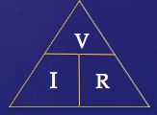
Let’s Practice

Slide 18
Assignment
For the rest of the period work on the 6.2 Assignment handout

Slide 19
Wrap Up
What is electric current?
What are the different things that make up Ohm’s Law?
What is resistance?

