Slide 1
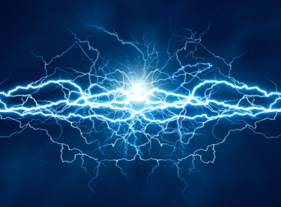
Electricity
Chapter 9 Section 1

Slide 2
Set Up Foldables

Slide 3
Electric Charge
Electric Charge – an electrical property of matter that creates electric and magnetic forces & interactions
Electric charge, like energy, is never created or destroyed only transferred
Like charges repel & opposite charges attract

Slide 4
Transfer of Electric Charge
Top of Flap
Protons = + (positive)
Neutrons = neutral
Electrons = - (negative)
Electric charge depends on an imbalance of protons and electrons
More electrons = bigger negative charge

Slide 5
Transfer of Electric Charge
Bottom of flap
When different materials rub together electrons can be transferred from 1 material to another
Direction of transfer depends on material
Conductors – substances that allow electricity to flow freely
Ex: metals (copper, aluminum, silver)
Insulators – substances that do not transfer charge easily
Ex: cardboard, glass, plastic

Slide 6
Electric Force
Electric Force – force of attraction or repulsion on a charged particle due to an electric field
Electric forces hold atoms and molecules together
Electric force depends on charge & distance
Charge = Electrical
Force
Distance = Electrical
Force
X2 charge = X2 Force
X2 Distance = X 1/2 Force

Slide 7
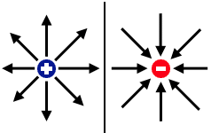
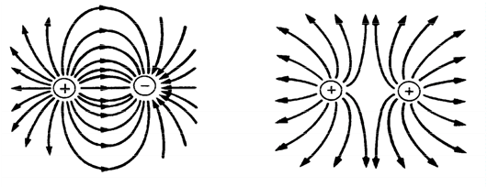
Electric Fields
Isolated Charges
Like & Opposite Charges

Slide 8
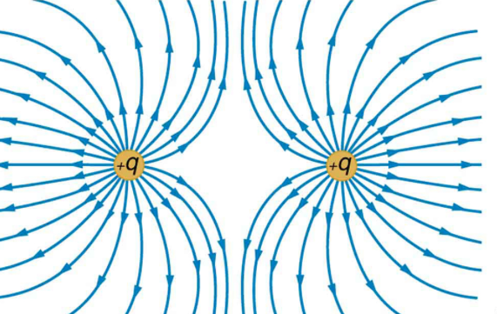
Electric Fields
Electric force acts through a field
Electric field – the space around a charged object in which another charged object experiences an electric force
To show an electric field, electric field lines are used
Electric Field lined NEVER CROSS each other

Slide 9
9.1 Review Questions
Describe the interaction b/w 2 like charges, then describe the interaction b/w 2 unlike charges.
Categorize the following as conductors or insulators:
Copper wire
Your body when your skin is wet
A plastic comb
Explain what happens to electric force b/w 2 positive charges under the following conditions:
Classify the electrical charge of the following:
Proton
Neutron
Electron

Slide 10
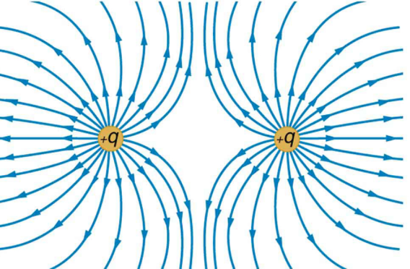
9.1 Review Questions
What missing electrical charge would result in the following field shown below?
-
?

