Slide 1
Conduction, Convection, & Radiation
Chapter 8 Section 2

Slide 2
Let’s Review- Conduction, Convection, Radiation
In your foldable yesterday we recorded the definitions of Conduction, Convection, and Radiation.
What is the difference between the three ways that energy is transferred?

Slide 3
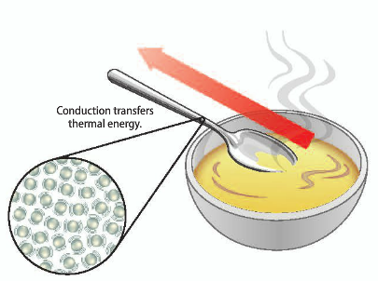
Conduction
Conduction: the transfer of thermal energy by collisions between particles that make up matter
Conductions occurs because particles that make up matter are in constant motion
For conduction to occur objects must be in contact with each other

Slide 4
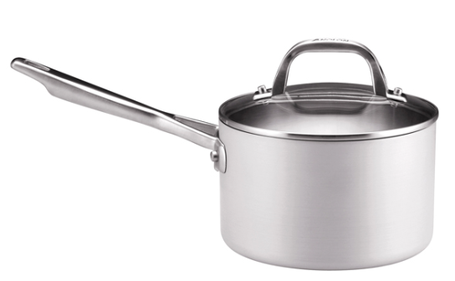
Conduction- Thermal Conductors
Thermal Conductors
The rate at which conduction transfers energy depends on the material
Conduction is faster in solids and liquids than in gases
In gases, particles are further apart and collisions are less frequent
The best thermal conductors are metals
This is why cooking pots are made of metal

Slide 5
Convection
Convection: the transfer of thermal energy in a fluid by the movements of warmer and cooler fluid
When conduction occurs, more energetic particles collide with less energetic particles and transfer thermal energy
Convection requires a transfer of energy by fluids

Slide 6
Convection- What’s Happening?
Most substances expand as their temperatures increase
This means that as particles move faster they tend to be further apart
Remember: density = mass ÷ volume
So as the fluid expands the volume increases but mass stays the same
This means the fluids density decreases when it is heated

Slide 7
Convection- What’s Happening cont…
Because fluids decrease in density when heated, fluids that absorb thermal energy decrease in density
The density for a warmer fluid is less than density of a cooler fluid
This difference in density is what drives convection
Warmer portions of the fluid rise to the top of the fluid and cooler portions sink
If a fluid is heated from below, convection currents form

Slide 8
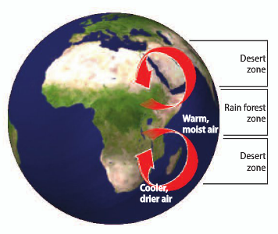
Convection Currents- Deserts & Rainforests
Earth’s atmosphere is a fluid that is made of various gases
The atmosphere is warmer at the equator than at the north and south poles
These temp differences
produce convection currents
that carry thermal energy away
from the equator
As the air rises is cools and loses moisture. Rain then falls over the equator

Slide 9
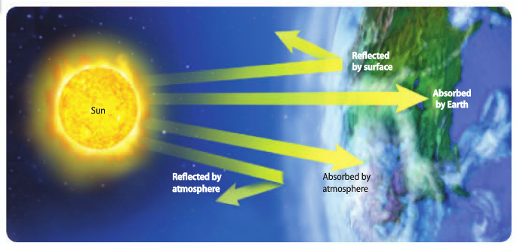
Radiation
Radiation: the transfer of energy by electromagnetic waves, such as light and microwaves
Radiation can travel through space even when matter is not present
Energy transferred by radiation is called radiant energy

Slide 10
Radiation and Matter
When radiation strikes a material, that material absorbs, reflects, and transmits some of the energy
The amount absorbed, reflected, or transmitted depends on the type of material
Thermal energy of a material increases when that material absorbs radiant energy

Slide 11
Radiation in Solids, Liquids, and Gases
In a solid, liquid, or gas radiation travels through the space between particles
Particles can absorb & re-emit this radiation
Radiation passes more easily through gases than solids or liquids (b/c of particle distance)
This means that radiation transfers energy more efficiently and rapidly through gases than through liquids or solids

Slide 12
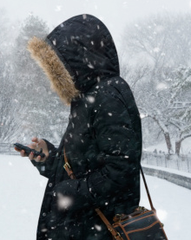
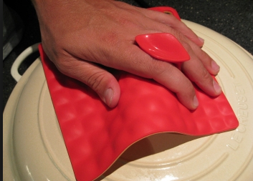
Controlling Heat
Remember heat is energy transferred b/w objects due to a temperature difference between the 2 objects
Everyday we do things to control the energy transfer between our bodies and the surroundings
Wearing a jacket, putting on an oven mitt, etc.
By doing this we are controlling heat

Slide 13
Controlling Heat- Thermal Insulators
Thermal insulator: a material through which thermal energy moves slowly
Good Thermal Insulators
Wood, fiberglass, air
Bad Thermal Insulators
Metals, other good conductors
Insulated Clothing
Some thermal insulators contain pockets of trapped air
Fleece jackets trap the air close to your body and the air slows the transfer of your body’s thermal energy to the surroundings

Slide 14
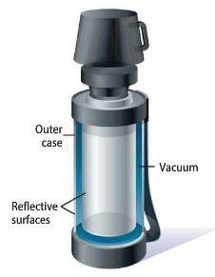
Insulated Buildings & Thermoses
Insulated buildings have fluffy material, such as fiberglass, that contains pockets of trapped air
Insulation helps furnaces and air conditioners work more efficiently
Thermoses contain two glass walls with very little air between these two walls (referred to by many as a vacuum)
Glass is a good thermal insulator and a vacuum is a very good thermal insulator
This prevents your food/drink from getting too cold/hot

Slide 15
Wrap Up
What are the three ways to transfer thermal energy?
What does each type of energy involve?
What is happening in convection currents?
What are two ways that we control heat?
What is a thermal insulator?

