Slide 1
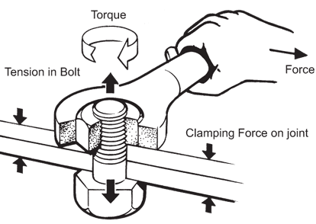
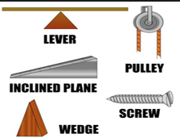
Torque & Simple Machines
Chapter 7 Section 4

Slide 2
What are we learning today?
The difference between torque and force
Calculate the magnitude of torque on an object
Identify the 6 types of simple machines
Calculate the mechanical advantage of a simple machine

Slide 3
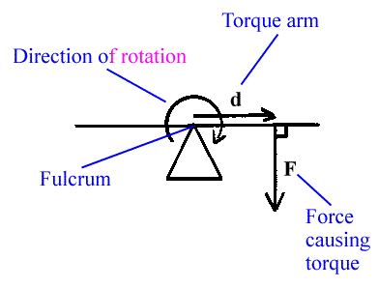
Rotational Motion
In this chapter we’ve discussed circular motion and objects that move in a circular path.
In this section we will examine a related type of motion: the motion of a rotating rigid object.

Slide 4
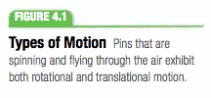
Rotational & Translational Motion

Slide 5
Torque
The ability of a force to rotate an object around some axis is measured by a quantity called torque
Torque depends on the force and the lever arm
How easily an object rotates depends not only on how much force is applied but also where the force is applied.
The farther from the axis of rotation, the easier it is to rotate the object and the more toque is produced.
The perpendicular distance from the axis of rotation to a line drawn along the direction of the force is called the lever arm.

Slide 6
Torques & Angles

Slide 7
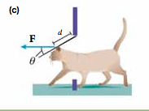
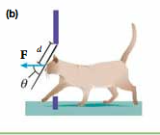
The Lever Arm Depends on the Angle
Forces do not have to be perpendicular to cause the object to rotate
When the angle is less than 90 degrees, the door will still rotate but not as easily

Slide 8
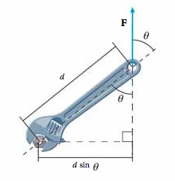
Torque
The symbol for torque is the Greek letter tau (τ)
SI unit of torque is Nxm

Slide 9
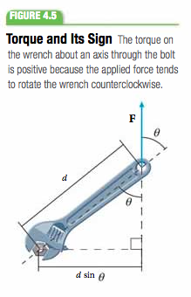
Torque & Its Sign
Torque is a vector quantity, meaning it has both a magnitude and a direction
This means that it must have a positive or negative sign depending on the direction the force tends to rotate an object
If force is directed up, up = positive, the motion is counterclockwise

Slide 10
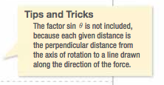
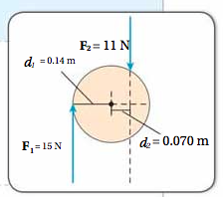
Practice Problem

Slide 11
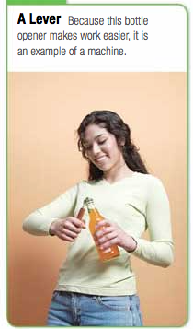
Types of Simple Machines
A machine is any device that transmits or modifies force, usually by changing the force applied to an object.
All machines are combinations or modifications of six fundamental types of machines
These six simple machines are:
Lever, Pulley, Inclined plane, Wheel & axle, Wedge, & Screw

Slide 12
6 Simple Machines

Slide 13
Using Simple Machines
The purpose of a simple machine is to change the direction or magnitude of an input force.
A useful way of characterizing a simple machine is to compare how large the output force is relative to the input force
This ratio is called the machine’s mechanical advantage

Slide 14
Mechanical Advantage & Torque
If friction is disregarded, the input torque will equal the output torque
The relationship can be written as follows:
Subbing this expression into the definition of mechanical advantage gives the following:

Slide 15
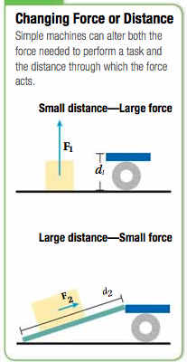
Machines Alter the Force & Distance Moved
A machine can (increase/decrease) the force acting on an object at the (expense/gain) of the distance moved, but the product of the two – the work done on an object – is constant.

Slide 16
Changing Force & Distance

Slide 17
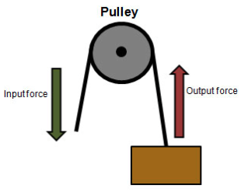
Efficiency of Machines
Real machines are not frictionless and thus they dissipate energy.
When the parts of a machine move and contact other objects some of the input energy is dissipated as sound or heat.
The efficiency of a machine is the ratio of useful work output to work input and is defined by the following equation:
If a machine is frictionless the output work = input work. Thus the mechanical energy of an ideal machine is 1 or 100%

Slide 18
Wrap Up
Determine whether each of the following situations involves linear motion, rotational motion, or a combo of the two:
A baseball dropped from the roof of a house
A baseball rolling toward third base
A door swinging open
What quantity describes the ability of a force to rotate an object?
How would the force needed to open a door change if you put the handle in the middle of the door?

