Slide 1
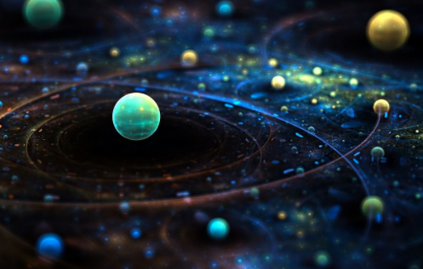
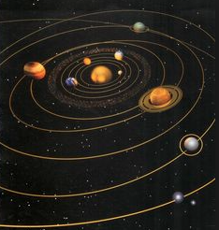
Motion in space
Chapter 7 Section 3

Slide 2
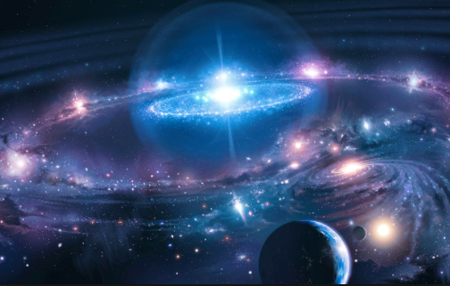
What are we learning today?
Kepler’s Laws of Planetary Motion
How Newton’s law of universal gravitation relates to Kepler’s laws
Orbital speed & period equations

Slide 3
History behind planetary motion
Until the mid 16th century most people believed Earth was the center of the universe
In the 2nd century, Claudius Ptolemy developed an elaborate theory of planetary motion w/ Earth still at the center of the universe
In his theory, planets travel in small circles called epicycles while simultaneously traveling in larger circular orbits
In 1543, Nicolaus Copernicus proposed that Earth and other planets orbit the sun in perfect circles
This wasn’t a new idea, a Greek named Aristarchus theorized 1700yrs before that Earth revolved around the sun but it was not widely accepted

Slide 4
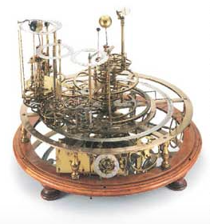
History of Kepler’s laws
The astonomer, Tycho Brahe made many precise observations of the planets and stars between 1546 and 1601. However, some of his ideas didn’t agree with the Copernican model
The astronomer, Johannes Kepler worked for years to reconcile the Copernican theory with Brahe’s data.
Kepler’s analysis led to three laws of planetary motion that were developed a generation before Newton’s law of universal gravitation.

Slide 5
Kepler’s Laws

Slide 6
Kepler’s Laws
Kepler’s 3rd Law
T (orbital period): the time a planet takes to finish one full revolution
r = (distance): mean distance b/w the planet and the sun

Slide 7
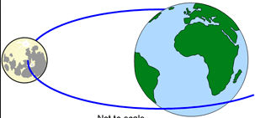
More history!
Newton used Kepler’s laws to support his law of gravitation
Newton proved that if force is inversely proportional to distance squared (as stated in his law of gravitation) thus the resulting orbit must be an ellipse or circle
Newton also demonstrated that his law of gravitation could be used to derive Kepler’s 3rd law.

Slide 8
Kepler’s 3rd law describes orbital period
According to Kepler’s 3rd law, T² α r³
The constant of proportionality between those two variables turns out to be 4π² / Gm where m is mass of the object being orbited
Thus, Kepler’s 3rd Law can be written as follows:
Using the square root of the above equation, you can describe the period of any object that is in a circular orbit

Slide 9
Kepler’s 3rd law

Slide 10
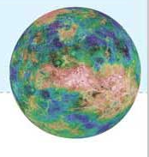
Practice problem

Slide 11
Weight and weightlessness
When weight is the only downward force acting on a scale, the scale reading equals your weight.
B/c of Newton’s 3rd law, the downward force you exert on the scale equals the upward force exerted
A feeling of weightlessness can occur when an object is in free fall. This can occur in elevators, some airplanes in rapid descent, and space.
The type of feeling you get while on Earth or in it’s atmosphere is called apparent weightlessness. True weightlessness can only occur in deep space, far from stars and planets.

Slide 12
Elevators and weightlessness

Slide 13
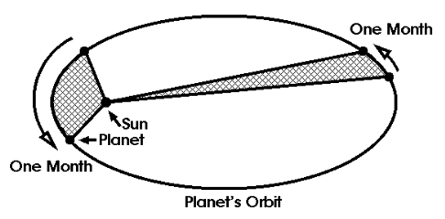
Kepler’s laws activity
In this activity you will need to create something that will help you remember the difference between each of Kepler’s laws and their corresponding numbers.
You may create:
A song
A drawing
A pneumonic (ex: PEMDAS)
A manipulative (something you can touch)

Slide 14
Wrap up
What is the difference between Ptolemy’s model and Copernicus’s model?
Does a planet in orbit around the sun travel at a constant speed? How do you know?
How do Kepler’s laws and Newton’s law of gravitation relate?

