Slide 1
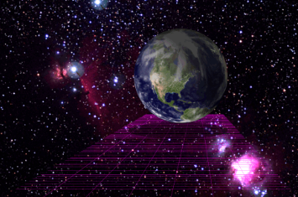
Newton’s Law of Universal Gravitation
Chapter 7 Section 2

Slide 2
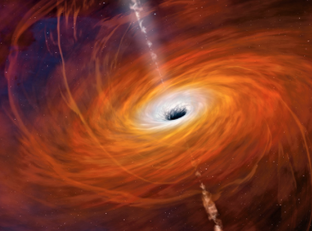
Black Hole Free Write
Read the short article on black holes on page 235 of your textbook
At the end of class you will write a ¾ - 1 page paper about how Newton’s Law of Universal Gravitation affects black holes, planets, and space

Slide 3
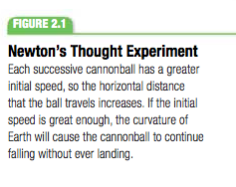
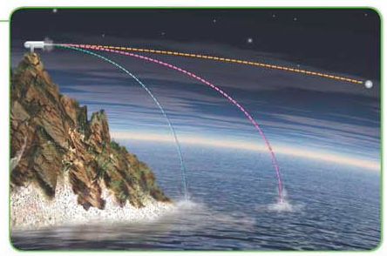
Orbiting Objects
Orbiting objects are in free fall
The force that pulls an apple toward the Earth is the same force that keeps the moon and satellites in orbit

Slide 4
Gravitational Force
Gravitational force depends on the masses and the distance
G = constant of universal gravitation = 6.673E−11 Nm²/kg²

Slide 5
Gravitational Force

Slide 6
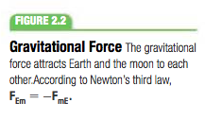
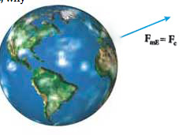
Gravitational Force & Masses
Gravitational force always attracts objects to one another
Gravitational force exists between any two masses, regardless of size.
Even your desks have a gravitational force attracting each other. However, it is negligibly small compared to the force between the Earth and the desk due to a difference in mass.

Slide 7
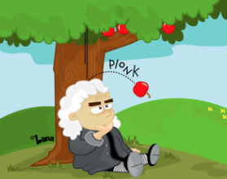
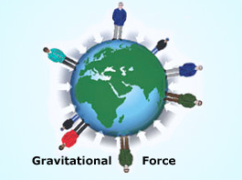
Practice Problem

Slide 8
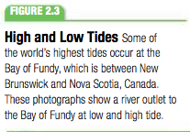
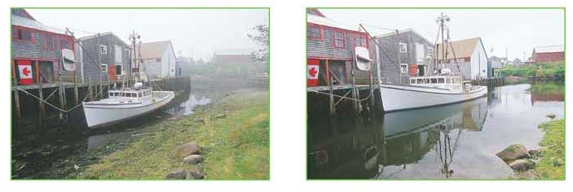
Applying the Law of Gravitation
The gravitational interaction between the moon and the earth cause tides in all bodies of water.

Slide 9
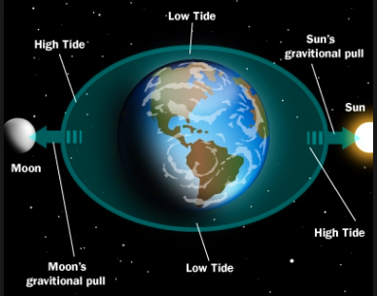
Law of Gravitation & Ocean Tides
Tides result from the difference between the gravitational force at Earth’s surface and at Earth’s center.
High tides take place at location on Earth nearly in line with the moon
The moon’s gravitational force is not the only factor though. Other influences, including the sun’s gravitational force, also play a role

Slide 10
Cavendish: Value of G + Earth’s Mass
In 1789, Henry Cavendish conducted an experiment that determined the value of the constant G.
Once he found the value of G, he used Newton’s Law of Gravitation to solve for the mass of the earth
His experiment:
Two small spheres are fixed to the ends of a suspended light rod.
They are attracted to two larger spheres by the gravitational force
The angle of rotation is measured with a light beam and is then used to determine the gravitational force between the two spheres
When the masses, distance between them, and gravitational force is known you can solve for G.

Slide 11
Cavendish’s Experiment

Slide 12
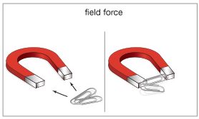
Gravity is a Field Force
Newton wasn’t able to explain how objects can exert forces on one another without touching.
His theory described gravity but didn’t explain how it worked.
Scientists theorized that masses create a gravitational field in space. Gravity is the interaction between a mass and the grav. force created by other masses
Ex: Raising a ball changes potential energy but the properties of the ball haven’t changed. However, the grav. field has changed.
According to field theory, the gravitational energy is stored in the gravitational field itself.
What is a Field Force?

Slide 13
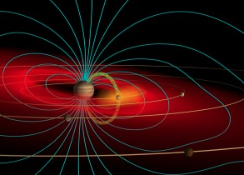
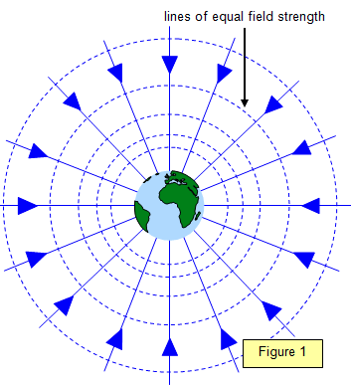
Describing Gravitational Field Strength
At any point, Earth’s gravitational field can be described by the gravitational field strength, abbreviated g.
The value of g is equal to the magnitude of the gravitational force exerted on a unit of mass at that point or g = F_{g}/m
The gravitational field (g) is a vector with a magnitude of g that points in the direction of the gravitational force

Slide 14
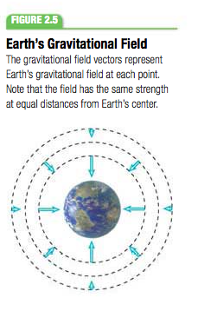
g = free-fall acceleration
Newton’s 2nd Law tells us that a = F/m
g = F_{g}/m where F_{g} is gravitational force
Looking at the two equations together tells us that at any given point g is equal to the acceleration due to gravity
g = 9.8 m/s² on Earth’s surface
Although they are equivalent they are not the same thing
Ex: an object at rest has no measurable acceleration but it is being pulled toward Earth’s surface and has a gravitational field strength

Slide 15
Weight Changes with Location
Newton’s Law of Universal Gravitation shows that the value of g depends on mass and distance.
These equations show the gravitational field strength depends only on mass and distance
Thus, as distance from Earth’s center increases your weight decreases

Slide 16
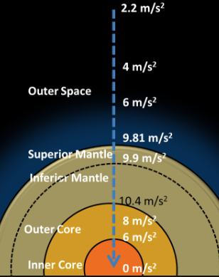
Gravitational Mass Equals Inertial Mass
In Newton’s 2nd Law, m is sometimes called inertial mass, because this m refers to the property of an object to resist acceleration.
In Newton’s Gravitation Equation, m is sometimes called gravitational mass, because this m relates to how object attract one another
The fact that the acceleration of objects in free fall on Earth’s surface is always the same confirms that the two types of masses are equal.

Slide 17
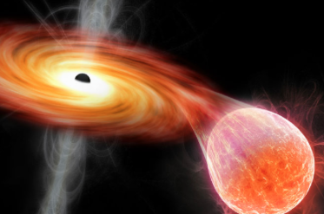
Free Write
Now spend the rest of the period writing about the prompt from the beginning of class
How does Newton’s Law of Universal Gravitation affects black holes, planets, and space?
Must be ¾ + pages

Slide 18
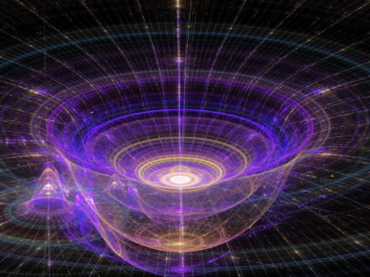
Wrap Up
What does gravitational force depend on?
What is happening with tides?
What does it mean to be a field force?
Why does your weight change on the moon but mass stays the same?

