Slide 1
Elastic & inelastic collisions
Chapter 6 Section 3

Slide 2
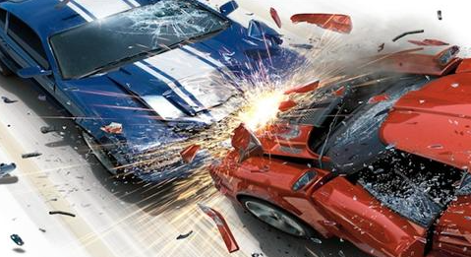
What are we going to study today?
Three types of collisions
Three new calculations
Changes in KE during the different types of collisions
Changes in velocity in the different types of collisions

Slide 3
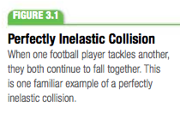
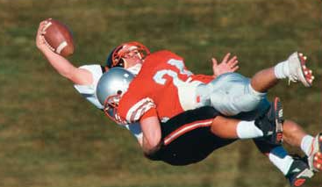
Perfectly Inelastic Collisions
Perfectly Inelastic Collisions: a collision in which two object stick together after colliding

Slide 4
Calculating Inelastic Collision
Perfectly inelastic collisions are easy to analyze in terms of momentum, b/c the objects become essentially one object after the collision.

Slide 5
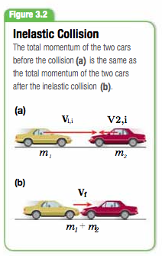
Inelastic Collision
The final mass is equal to the combined masses of the colliding objects.
The combination moves with a predictable velocity after the collision.

Slide 6
Practice Problem

Slide 7
Kinetic Energy in Inelastic Collisions
In inelastic collisions, the total kinetic energy does not remain constant when the objects collide.
Some KE is converted to sound energy & internal energy as the objects deform during collision
“Elastic” implies that work done to the material during collision is equal to the work done to return the material to its original shape
During inelastic collisions some energy is “lost” to conversions into other forms

Slide 8
Calculating KE Lost in Inelastic Collisions

Slide 9
KE Practice Problem
HINT:
1st calculate V_{f} using the perfectly inelastic collision equation
2nd calculate Initial kinetic energy & final kinetic energy
3rd calculate ΔKE

Slide 10
Elastic Collisions
Elastic Collision: a collision in which the total momentum and the total kinetic energy are conserved
After the collision, the two objects move separately
Both the total momentum and total KE are conserved

Slide 11
Normal “Real Life” Collisions
Most collisions are neither elastic nor perfectly inelastic
Colliding objects do not usually stick together & continue to move as one object
Thus most collisions are not inelastic
Most collisions are not elastic either so there is a “middle” category that normal collisions fall under
This middle category is called inelastic collisions (not to be confused with perfectly inelastic)
Inelastic collisions: colliding objects bounce and move separately after the collision, but total KE decreases during the collision
We will deal with this type of collision

Slide 12
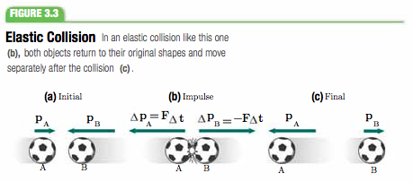
KE Conserved in Elastic Collisions
The total momentum is always constant throughout the collision.
In addition, if the collision is perfectly elastic, the value of the total kinetic energy after the collision is equal to the value before the collision

Slide 13
Elastic Collisions Practice Problems

Slide 14
Bring it all Together

Slide 15
Wrap Up
What are the three types of collisions we talked about in this section?
What type of collision is seen in normal “real life” collisions?
What are the three equations from this section?
In which type of collision is KE conserved?

