Slide 1
Conservation of Momentum
Chapter 6 Section 2

Slide 2
Bell Ringer
What do we know about momentum right now?
What do you think the law of conservation of momentum will tell us?
Momentum would not be conserved “in system” if what occurred?

Slide 3
Law of Conservation of Momentum
Law of Conservation of Momentum: the total momentum of all objects interacting with one another remains constant regardless of the nature of the forces between objects

Slide 4
Momentum is Conserved in Collisions
In this book, most conservation of momentum problems deal with only 2 isolated objects.
However, it is important to understand all objects involved in the interaction (such as friction)
Frictional forces & air resistance are mostly disregarded in these problems

Slide 5
Momentum in Collisions

Slide 6
Objects Pushing Away
When two or more objects push away from each other total momentum is conserved.
Momentum may be transferred from one object to another but cannot be destroyed

Slide 7
Objects Pushing Away

Slide 8
Practice Problems

Slide 9
Newton’s 3rd Law & Conservation of Momentum
Equal & opposite forces

Slide 10
Conserving “p” in Equations
Momentum

Slide 11
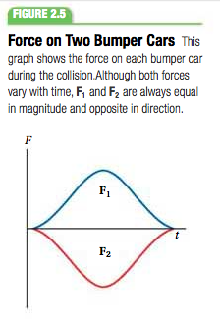
Forces in Collision
Forces in real collisions are not constant during the collisions
Although both forces vary with time they are equal and opposite in direction
Magnitudes of forces change throughout the collision- increasing, reaching a max, and decreasing.

Slide 12
Wrap Up
What does the Law of Conservation of Momentum state?
How does Newton’s 3rd Law relate to momentum?
What equation did we use in this section?

