Slide 1
Chapter 5 Section 3
Acceleration
IPC

Slide 2
Acceleration Free Write
On a piece of paper, write down what you know about the following questions:
What happens to acceleration when you slow down?
If you throw a ball straight up, what happens to the acceleration?
What is the acceleration when the ball as at the peak height (where it can no longer go up and has not yet begun to fall)?

Slide 3
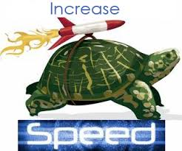
Velocity and Acceleration
Acceleration: the rate of change of velocity
Units: m/s²
Remember: velocity is a change in speed or direction
Acceleration occurs when an objects changes its speed, its direction, or both

Slide 4
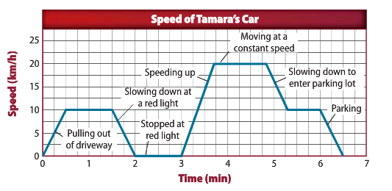
Speed-Time Graphs
When an object travels in a straight line and does not change direction, a graph of speed vs time can provide info about the object’s acceleration.
The slope on a speed-time graph equals the object’s acceleration

Slide 5
Identify & Label
Identify and label the places on the graph where acceleration is occurring

Slide 6
Calculating Acceleration
Acceleration: the rate of change in velocity (m/s²)
Acceleration Equation:
Acceleration (m/s²) = change in velocity (m/s)
time (s)
a= V_{f} – V_{i}
t
In some cases, your calculations will result in a negative acceleration. The negative sign for acceleration means in the opposite direction.

Slide 7
Motion in 2-D
Thus far we have only discussed motion in a straight line, but most objects do not move in a straight line only.
Remember that we cannot add measurements that are not in the same or opposite directions
As such, we will discuss motion in each direction separately
This also means that we cannot use the acceleration equation because of its’ reliance on velocity.

Slide 8
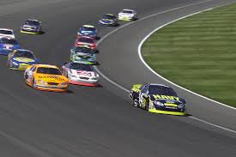
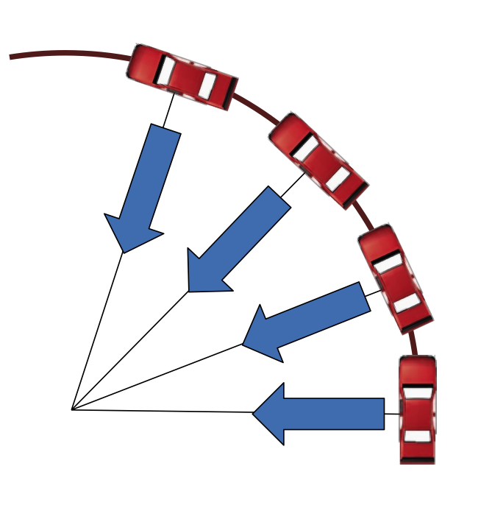
Circular Motion
Centripetal acceleration: acceleration toward the center of a curved or circular path
What other examples of centripetal motion have you seen?

Slide 9
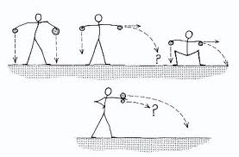
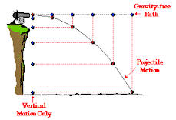
Projectile Motion
Horizontal and vertical motion
When you throw or shoot an object the force exerted by your hand give the object horizontal velocity. The horizontal velocity is constant.
When you release a rubber band, gravity causes it to accelerate downward causing the rubber band to have increasing vertical velocity

Slide 10
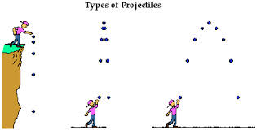
Throwing and Dropping
If you throw a ball as hard as you could in a perfectly horizontal direction, would it take longer to reach the ground than if you dropped the ball from the same height?
Actually it would not!
The vertical distance traveled
by both objects is the same.
The horizontal distance travelled by the thrown object is greater. (This means the energy spent on throwing the ball is used by traveling a greater distance horizontally.)

Slide 11
Throwing and Dropping cont.
Ex: If you shoot a bullet horizontally will it hit the ground at the same time as a bullet you drop vertically from the same height.
The two bullets will hit the ground at the same time!

Slide 12
Types of Acceleration Activity
In groups, demonstrate three ways to accelerate while walking.
Keep in mind the definition of acceleration (a change in velocity divided by a change in time)
Be ready to verbally justify your reasoning and explain why walking at a constant speed is not accelerating

Slide 13
Wrap Up
What are two things that affect acceleration?
What is centripetal acceleration?
Why does a dropped object hit the ground at the same time as an object thrown horizontally?
Have a Great Day!

