Slide 1
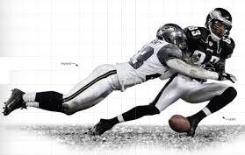
Chapter 2 Section 2
Velocity and Momentum
IPC

Slide 2
Velocity and Escalators Free Write
On a piece of paper anwer the following questions… Must be at least half a page in length
Have you ever noticed those people that walk up the ascending escalator? Why do you think they do that?
When people walk up the ascending escalator do they have a higher velocity than the stationary passengers?
Is the speed the same for the ascending and descending escalators?
What about the velocity?

Slide 3
Velocity and Speed
Velocity: includes the speed of an object and the direction of its motion
Units for velocity are the same units used for speed (m/s)
Because velocity depends on direction, the velocity of an object can change even though speed remains constant
Ex: Ascending and descending escalators
Same speed, different velocities (because of different direction)

Slide 4
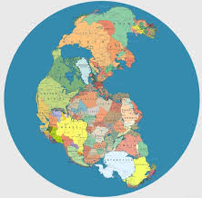
Motion of Earth’s Crust
In the early 1900s, Alfred Wegener, a German meteorologist developed the theory that all Earth’s continent were once part of a single landmass known as Pangaea
Slowly, earth’s tectonic plates have been drifting apart in a motion known as continental drift
The plates move so slowly their speeds are given in units of centimeters per year

Slide 5
Relative Motion
Have you ever watched cars pass you on the highway? Those passing in the same direction seem to be moving slowly, while those traveling in opposite direction seem to fly by.
The choice of reference point affects how you describe motion.
Velocity and position always depend on the point of reference chosen.

Slide 6
Momentum
Momentum: the product of an object’s mass and velocity
Ex: Calculate the momentum of a car with the following stats:
mass = 47.0 kg
velocity = 15.0 m/s West
p = ?
Momentum (kg × m/s) = mass (kg) × velocity (m/s)
p = mv
p = mv
p = (47.0 kg) (15.0 m/s)
p = 705 kg×m/s

Slide 7
Activity
Momentum in Sports
Choose one sport that you think momentum plays an important role in (football, basketball, soccer, etc)
Write down two things a player of that sport could do to increase there momentum
Make sure to justify your answers
Keep in mind the definition of momentum when working on this activity
At the end of the activity you will demonstrate these two things and explain them so be ready!

Slide 8
Homework
Work on velocity and momentum handout
We will spend the next class period working on it
Be sure to work through the homework tonight and come with questions

Slide 9
Wrap Up
What is the difference between velocity and speed?
Knowing the momentum equation, which vehicle has a greater momentum if they are traveling at the same velocity, a car or a truck-tractor-trailer (18 wheeler)? Why?
Have a Great Day!

