Slide 1
Chapter 5 Section 1
Describing Motion
IPC

Slide 2
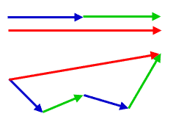
What’s in a “Vector”?
Watch the following video:
https://www.youtube.com/watch?v=GKQdkS0qG3g
From the video, what do you now know about vectors?
How do you think vectors are used in physics?

Slide 3
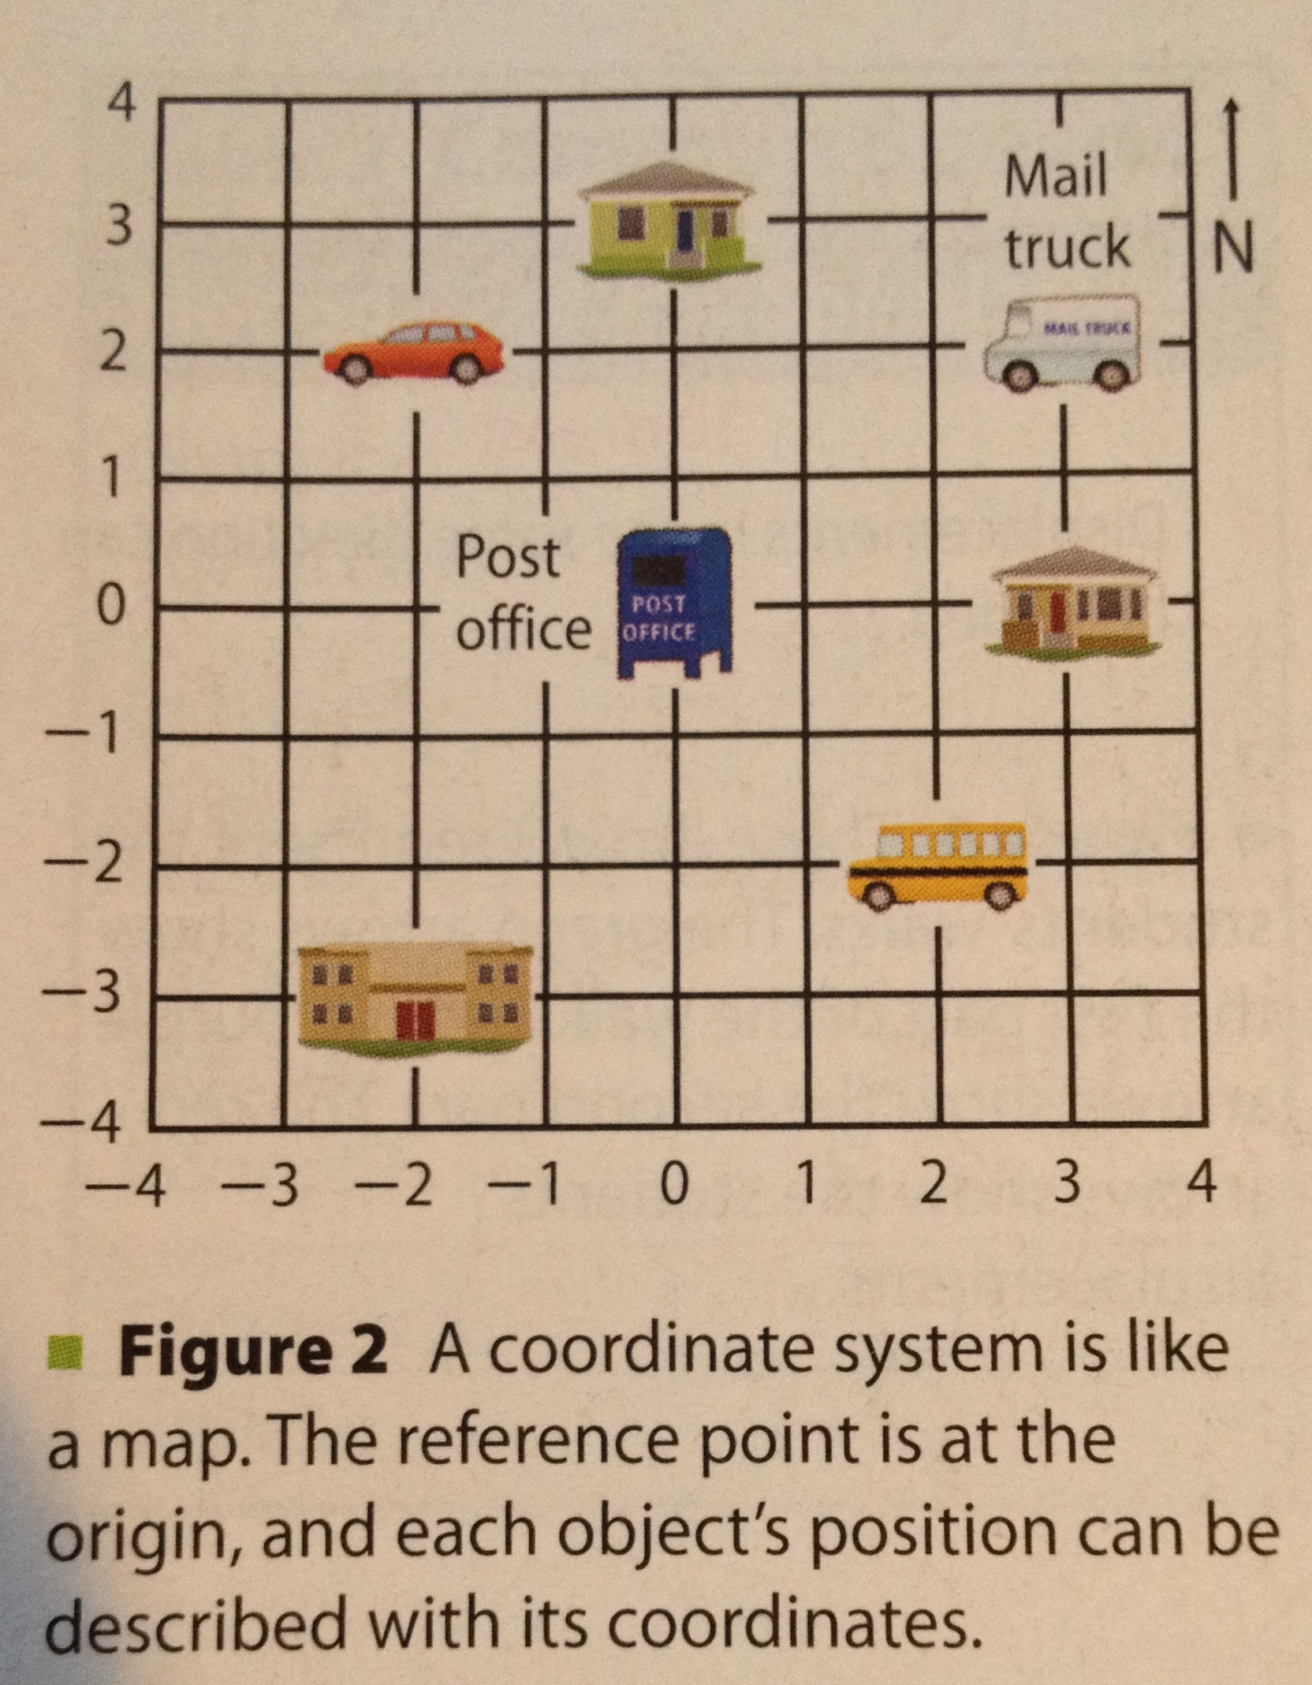
Motion and Position
Motion: a change in an object’s position relative to a reference point
Reference point: a chosen point used to determine an object’s position (see Figure 1 on pg 44)
Once a reference point is chosen a frame of reference can be created
A frame of reference is a coordinate system in which the
position of the object is measured (Like a map)

Slide 4
Change in Position
Distance: SI Unit is meters (m)
Long distances are often measured in kilometers (km)
1 km = 1000m
Displacement: the distance and direction of the object’s change in position
Ex:
Displacement = 100m – 35m = 65m East
Vector arrows are used to help denote a change in displacement
100m East
Vectors
35m West

Slide 5
Adding Displacements
There are 3 rules for displacement:
Add displacements in the same direction
Subtract displacements in opposite directions
Displacements not in the same or opposite directions cannot be directly added together (and should be discussed separately)

Slide 6
Speed
Speed: the distance an object travels per unit of time
Speed Equation:
speed (meters/second) = distance (meters)
time (seconds)
Ex:
A car traveling at a constant speed covers a distance of 1250m in 45s. What is the car’s speed?
Speed = ?
Distance = 1250m
Time = 45s
d
s
t
s = d
t
s = (1250m)
(45s)
= 28 m/s

Slide 7
Speed cont.
Constant speed: a speed where you neither speed up or slow down
Calculate constant speed by taking the distance and time values at any point and using the speed equation
Changing speed: a speed that is not constant
Average speed: one way to describe changing speed
Avg. speed = Total distance traveled divided by total time
Instantaneous speed: speed shown at a specific point in time
The instantaneous speed of an object moving at a changing speed is different at every point in time
The instantaneous speed of an object moving at constant speed does not change

Slide 8
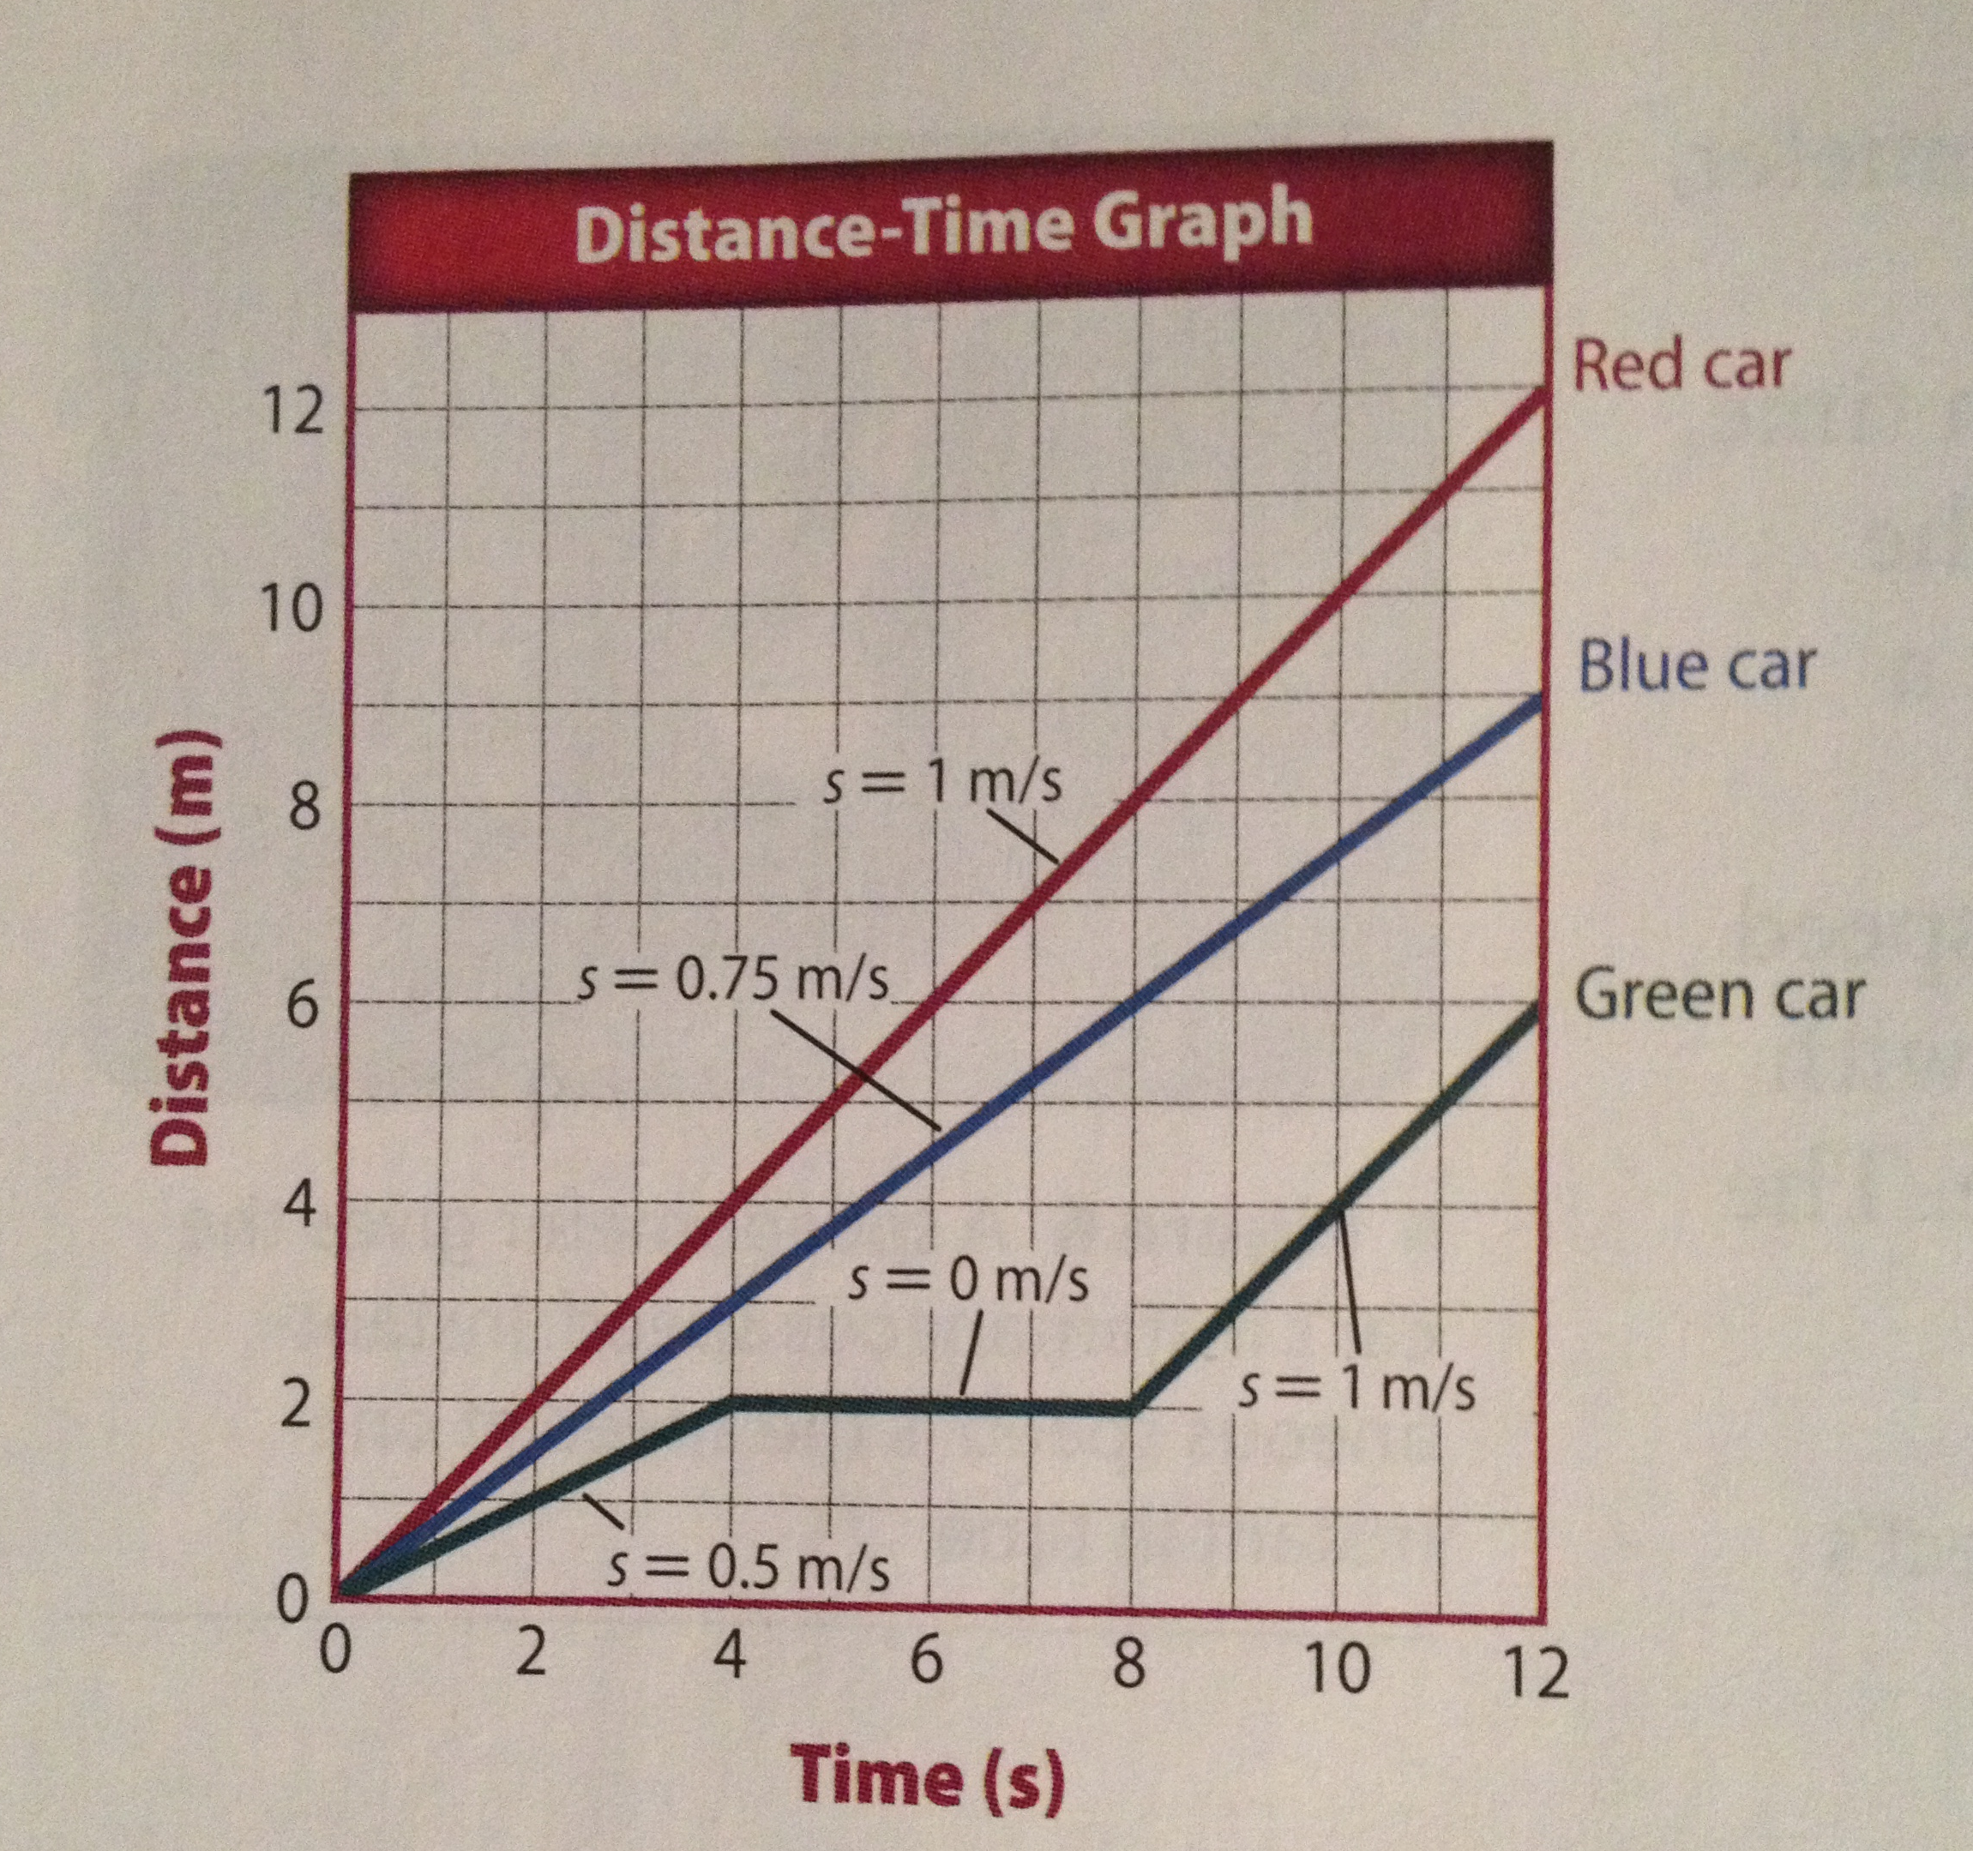
Graphing Motion
The motion of an object over a period of time can be shown on a distance-time graph
Time is plotted on the horizontal (x-axis)
Distance is plotted on the vertical (y-axis)
Speed on distance-time graphs
The slope of the line on a distance time graph equals the object’s speed
Slope = rise/run= y-value/x-value

Slide 9
Homework
Begin work on 5.1 Calculations
Tomorrow we will spend time in class working on them together so come in with questions!

Slide 10
Wrap Up
What is one thing new that you learned today?
What is the difference between distance and displacement?
What are the units for speed?
Why are reference points used?
Have A Great Day!

