Slide 1
Everyday Forces
Chapter 4 Section 4
Purvis – Honors Physics

Slide 2
Objectives
Explain the difference between mass and weight
Find the direction and magnitude of normal forces
Describe air resistance as a form of friction
Use coefficients of friction to calculate frictional forces

Slide 3
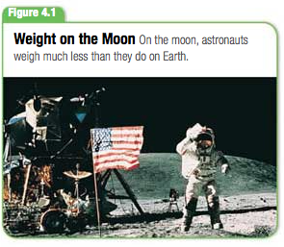
Weight
Mass = the amount of matter in an object
The gravitational force exerted on a bowling ball by Earth, F_{g} , is a vector quantity, directed toward the center of Earth
The magnitude of this force is a scalar quantity called weight.
Weight: a measure of the gravitational force exerted on an object
It’s value can change with the location of the object in the universe
Ex: Weight on the moon vs weight on Earth is different due to gravity’s difference on the moon

Slide 4
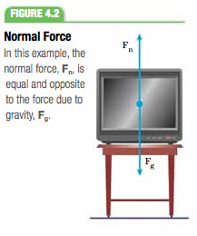
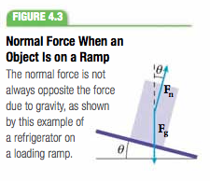
Normal Force
Normal Force: Force that acts on an object lying on a surface, acting in a direction perpendicular to the surface.
Normal force is always perpendicular to the contact surface

Slide 5
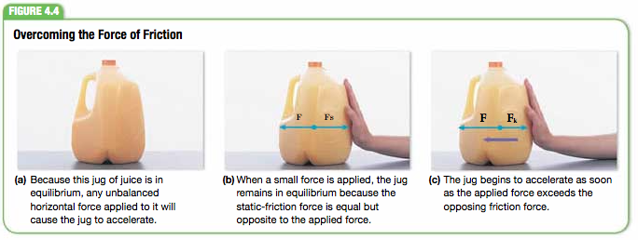
Force of Friction
Friction opposes applied force
Static Friction: the force that resists the initiation of sliding motion between two surfaces that are in contact at rest
Abbreviated F_{s}

Slide 6
Kinetic Friction < Static Friction
When the applied force exceeds the max F_{s} then the jug begins to move
There is still a frictional force acting on the jug as it moves but this force is less than static friction
Kinetic Friction: the force that opposes the movement of two surfaces that are in contact and are sliding over each other
Also known as sliding friction
F_{net} = F_{applied} - F_{k}

Slide 7
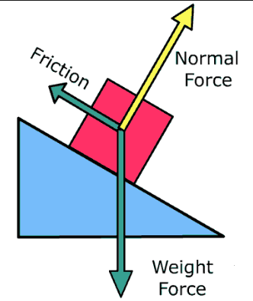
Friction & Normal Force
The force of friction is proportional to the normal force
The magnitude of the force of friction is approximately proportional to the magnitude of the normal force that a surface exerts on an object
Because a desk is heavier than a chair, the desk experiences a greater normal force and thus a greater frictional force than a chair

Slide 8
Surface Types & Coefficient of Friction
The force of friction also depends on the surfaces in contact
Ex: its easier to push a fridge across a tile floor than carpet
The normal force is the same in both cases but frictional force is higher b/w carpet and the fridge
Coefficient of Friction: the ratio of the magnitude of the force of friction b/w two objects in contact to the magnitude of the normal force w/ which the objects press against each other
Equation on next slide
Represented w/ greek letter mu (μ)

Slide 9
Coefficient of Friction
Coefficient of Friction = ratio of frictional force to the normal force b/w two surfaces
Coeff. Of Kinetic Friction
Coeff. Of Static Friction

Slide 10
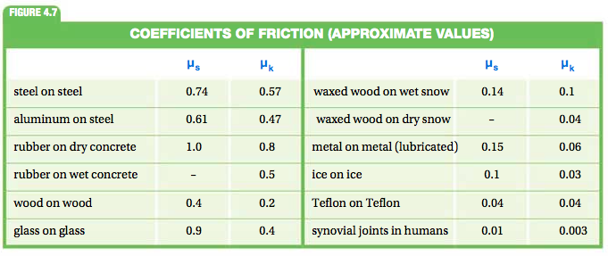
Given Values for Coefficients of Friction

Slide 11
Air Resistance & Friction
Air resistance is another type of friction that is important for the analysis of motion
As a free-falling body accelerates towards earth its velocity increases
As the velocity increases, the resistance of the air to the object’s motion is also constantly increasing.
When upward force of air resistance balances downward gravitational force, the net force on the object is zero, and the object continues downward w/ constant max speed called terminal velocity

Slide 12
4 Fundamental Forces
There are 4 Types of forces
Gravity
Weakest of the 4
Acts over great distance
Binds stars/galaxies together
Range is infinite
Electromagnetic Force
Stronger than gravity
Responsible for holding atoms/molecules together
Weak Force
Limited range
Operate w/in atomic nucleus
Cause forms of radioactivity and underlies nuclear reactions that fuel the sun
Strong Force
Strongest force known
Binds quarks and anti-quarks together w/in particles
Locks quarks together so you don't see single quarks

Slide 13
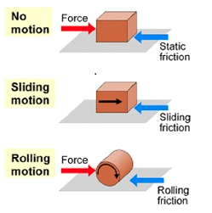
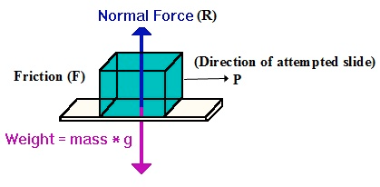
Wrap Up
Know the difference b/w mass & weight
Understand normal & frictional forces
Describe air resistance as friction
Use coefficient of friction values to calculate frictional force

