Slide 1
Newton’s 2nd and 3rd Laws
Chapter 4 Section 3
Purvis – Honors Physics

Slide 2
Objectives
Describe an object’s acceleration in terms of its mass and the net force acting on it
Predict the direction and magnitude of the acceleration caused by a known net force
Identify action-reaction pairs

Slide 3
Newton’s 2nd Law

Slide 4
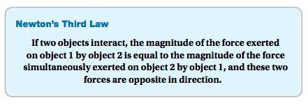
Newton’s 3rd Law
Simply: For every action there is an equal and opposite reaction
When 2 objects interact with one another, the forces the objects exert on each other are called an action-reaction pair

Slide 5
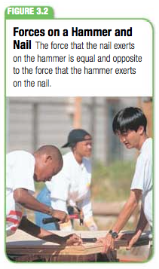
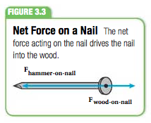
Action-Reaction Forces
Action-reaction forces occur at the same time on a pair of objects (the reaction force is not after the action force)
Each force acts on a different object
The action force is exerted by hammer. The reaction force is exerted by the nail.

Slide 6
Field Forces
Newton’s 3rd Law also applies to field forces (they also exist in pairs)
Remember: field forces are forces that do not have to be touching an object to exert a force on it
Ex: a dummy thrown out of a plane
The Earth exerts a gravitational force on the dummy (action force)
The dummy exerts a force on the Earth (reaction force) equal to the force exerted by gravity

Slide 7
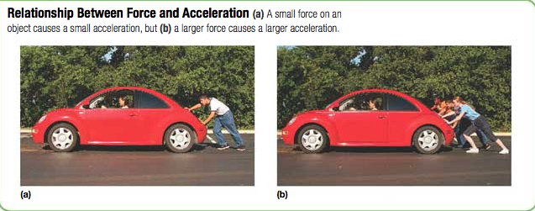
Wrap Up
Be sure that you understand Newton’s 2nd and 3rd laws
Understand and be able to identify action and reaction forces in a given situation

