Slide 1
Newton’s 1st Law
Chapter 4 Section 2
Purvis- Honors Physics

Slide 2
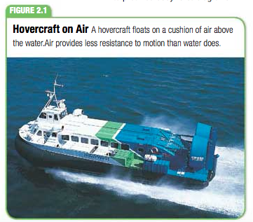
Objectives
Explain the relationship between the motion of an object and the net external force acting on the object
Determine the net external force acting on an object

Slide 3
Newton’s First Law & Inertia
Inertia is the tendency of an object to resist a change in motion
Newton’s first law is often referred to as the law of inertia

Slide 4
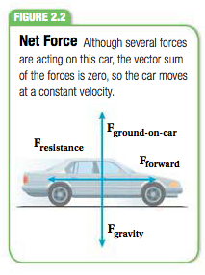
Net Force
The vector sum of forces acting on an object is the net force
Net force: a single force whose external effects on a rigid body are the same as the effects of several actual forces acting on the body

Slide 5
Mass is a measure of Inertia
Mass measures the amount of matter in an object
If you try to push a basketball vs a bowling ball think about the force it requires to move each
If you push with equal force the basketball will accelerate more because it has less inertia than the bowling ball with a greater mass.

Slide 6
Net Force Calculation
Go watch the video for calculating net force

Slide 7
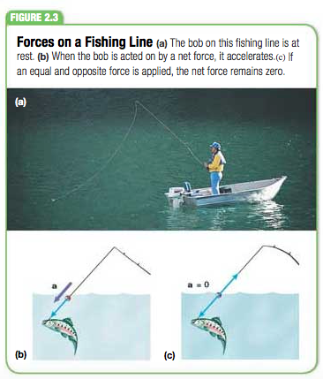
Equilibrium
Equilibrium is the state in which the net force on an object is zero.

Slide 8
Wrap Up
Make sure that you know the following:
Newton’s 1st Law
Inertia
Net force
+ be able to calculate net force
Equilibrium

