Slide 1
Changes in Motion
Chapter 4 Section 1

Slide 2
Objectives
Describe how force affects the motion of an object
Interpret and construct free-body diagrams

Slide 3
Force
Force: an action exerted on an object that may change the object’s state of rest or motion
You see forces every day in every movement of an object
You even see forces when objects are at rest

Slide 4
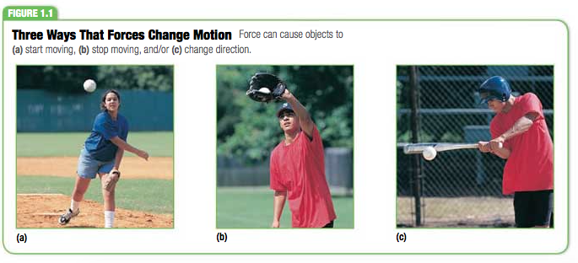
Force & Acceleration
Forces can cause acceleration in 3 ways:
Remember acceleration is a change in velocity over a change in time
Start Moving
Stop Moving
Change Direction

Slide 5
Force Equation & Units
Force Equation:
Force = Mass x Acceleration
(Newtons)= N = kg x m/s²
A Newton is defined as the amount of force that , when acting on 1 kg mass, produces an acceleration of 1 m/s²
*** We will discuss this equation more in the coming chapters. Just make sure you write it down for now & understand the units .***

Slide 6
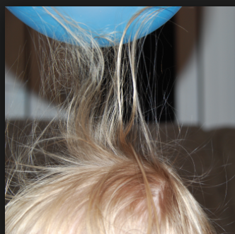
Forces: Through Contact & Distances
Contact Forces: pushes/pulls that are the result of physical contact between two objects
Ex: hitting a ball
Field Forces: pushes/pulls that don’t involve physical contact between two objects
Ex: gravity’s affect on a skydiver
Ex: Static on a balloon lifting your hair

Slide 7
Force Diagrams
Force diagrams: diagrams that show force vectors as arrows
Arrow’s tail is attached to the object on which the force is acting
The vector points in the direction of the force
Vector length is proportional to the magnitude of the force
Force diagrams are also called free-body diagrams

Slide 8
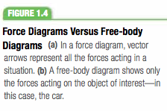
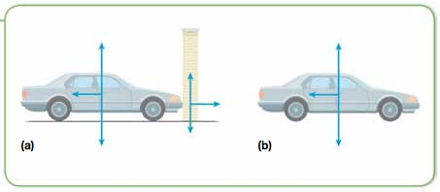
Analyzing Given Situations
Free-body diagrams help analyze the forces affecting the motion of a single object
We will use free-body diagrams to solve for component and resultant vectors

Slide 9
Drawing Free-Body Diagrams
Go see the Drawing Free-Body Diagrams video on the website!

Slide 10
Wrap Up
Be able to list three examples of each of the following:
Force causing an object to start moving
Force causing an object to stop moving
Force causing an object to change direction
Understand the difference b/w field and contact forces
Be ready to draw free-body diagrams

