Slide 1
Vector Operations
Chapter 3 Section 2
Purvis – H.Physics

Slide 2
Objectives
Identify appropriate coordinate systems for solving problems with vectors
Apply the Pythagorean theorem and tangent function to calculate the magnitude and direction of a resultant vector
Resolve vectors into components using the sine and cosine functions

Slide 3
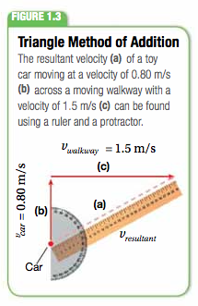
Reminder from Section 1
Don’t forget the triangle method of addition from section 1 before Christmas break
Go back and review that section if necessary

Slide 4
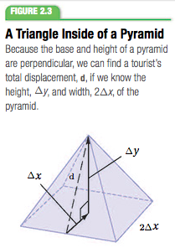
Pythagorean Theorem Method
This is similar to the graphing method we used in section one but is much simpler and more accurate

Slide 5
Finding the Direction of the Resultant
To completely describe the displacement of an object you must know direction and magnitude (you’ve found magnitude using the Pythagorean theorem)
To find direction you will use the tangent function on your calculators

Slide 6
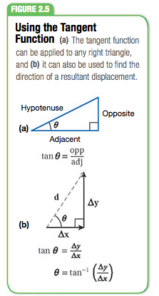
How to use tangent to solve
To find the angle you must use the inverse tangent function to find the direction of the resultant vector
The units will simply be degrees

Slide 7
Solving using Tangent Video
Go watch the first video on the website
You may watch the videos before or after taking the rest of the notes

Slide 8
Resolving Vectors into Their Components: Equations
**Write down these equations. I will show you how to use them momentarily. **

Slide 9
Resolving Vectors into Components Video
Go watch the second video on the website
You may watch the videos before or after taking the rest of the notes

Slide 10
Adding Vectors that Aren’t Perpendicular
Until now you have not been able to add vectors that aren’t perpendicular
Because they do not form a right triangle we cannot use the tangent or Pythagorean methods we just learned
First you must resolve the vectors into their x and y components and then they can be added together
Figure on next slide**

Slide 11
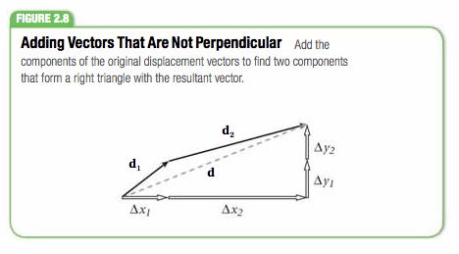
Adding Vectors that Aren’t Perpendicular

Slide 12
Adding Non-Perp. Vectors Video
Go watch the third video on the website
You may watch the videos before or after taking the rest of the notes

Slide 13
Wrap Up
We’ve learned how to solve:
Using Tangent functions
Using the Pythagorean Theorem method
Using sine and cosine functions
Non-perpendicular vectors algebraically
We will spend the next few days working on these problems together.
Don’t forget to work on your PoTW (it will be due on Friday)

