Slide 1
Electricity and Magnetism
Chapter 10 Section 2

Slide 2
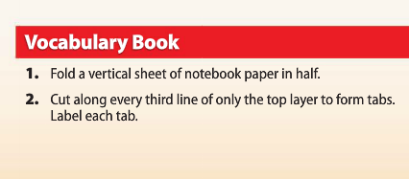
CYO Vocab Foldable

Slide 3
How It Was Discovered
In 1820, Danish physics teacher Hans Oersted found that electricity and magnetism are related
While doing a demo on electric current, he happened to have a compass near an electric circuit.
He noticed that the current affected the direction of the compass needle.
Oersted hypothesized that the electric current must produce a magnetic field around the wire and the direction of the field depends on the direction of the current.
We now know that his hypothesis was correct and that all moving charges, like those in electric currents, produce magnetic fields.

Slide 4
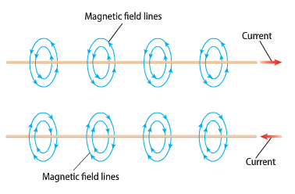
Electric Current and Magnetism
Around a current carrying wire, the magnetic field lines form circles
The direction of the magnetic field around the wire reverses when the direction of the current in the wire reverses
The strength of the magnetic field can be increased by increasing the current in the wire.

Slide 5
Electromagnetism
Moving electric charges are surrounded by magnetic fields
The interactions between moving electric charges and magnets led scientists to realize that electric force and magnetic force are part of the same force, called electromagnetic force
Electromagnetic force is the attractive or repulsive force between electric charges and magnets
The interaction between electric charges and magnets is called electromagnetism.
Electromagnetism is what makes magnets so useful
Many devices, like MP3 players, operate because of these interactions

Slide 6
Electromagnets
The magnetic field around a current carrying wire can be made stronger by changing the shape of the wire
When there is a current in a wire loop, the magnetic field inside the loop is stronger than the field around a straight wire
A single wire wrapped into a cylindrical wire coil is called a solenoid.
The magnetic field inside a solenoid is stronger than the field in a single loop
The magnetic field around each loop in the solenoid adds together to form a field.

Slide 7
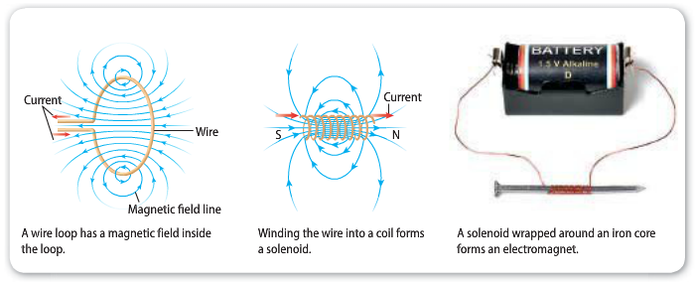
Electromagnets cont.
An electromagnet is a temporary magnet created when there is a current in a wire coil.
Often, the current carrying coil is wrapped around an iron core. The coil’s magnetic field temporarily magnetizes the iron core

Slide 8
Properties of Electromagnets
An electromagnet behaves like any other magnet when there is a current in the solenoid
One end is the north pole, and the other end is the south pole
If placed in a magnetic field, an electromagnet will align itself along the magnetic field lines
Electromagnets are useful because their magnetic properties can be controlled by the user

Slide 9
Making an Electromagnet Rotate

Slide 10
Using Electromagnets
When an electromagnet rotates, electrical energy is converted into mechanical energy to do work
Electromagnets do work in various devices, such as stereo speakers and electric motors

Slide 11
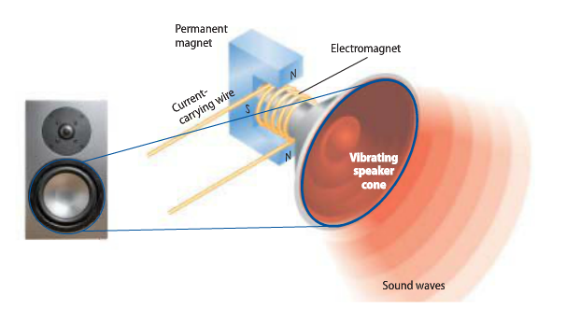
Speakers
The electromagnet changes electrical energy into mechanical energy that vibrates the speaker cone to produce the sound you hear.

Slide 12
Galvanometers
A galvanometer is a device that uses an electromagnet to measure electric current
Examples of galvanometers are gauges in a vehicle (gas gauge, temperature gauge, etc.)
In a car, the float in the fuel tank is attached to a sensor.
The sensor sends a current to the fuel gauge galvanometer
As the level of the float in the tank changes, the amount of current sent by the sensor changes and rotation of the needle changes.
The gauge is calibrated so the current sent when the tank is full causes the needle to rotate to the full mark on the scale

Slide 13
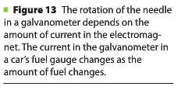
Galvanometers

Slide 14
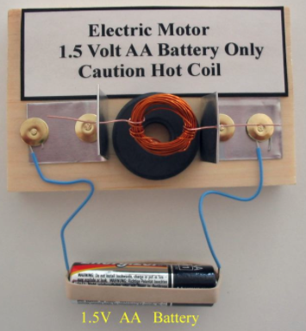
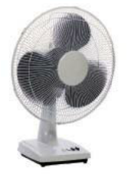
Electric Motors
An electric motor is a device that changes electrical energy into mechanical energy
Electric motors are used in all types of industries and equipment (industry, agriculture, transportation, etc)
Electric motors are found in every room in your house
DVD players, game systems, computers, hair dryers, fans, etc.

Slide 15
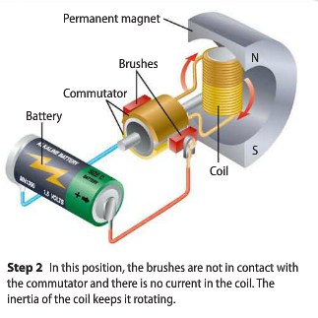
Simple Electric Motors

Slide 16
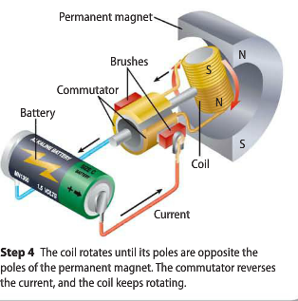
Simple Electric Motors cont.

Slide 17
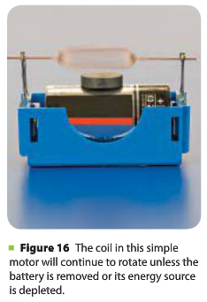
Making the Motor Spin
When there is a current in the coil, the forces between the coil and the permanent magnet cause the coil to rotate
The coil will continue to rotate as long as the battery remains connected

Slide 18
Assignment
Work on 7.1/7.2 Combo Handout

Slide 19
Wrap Up

