Slide 1
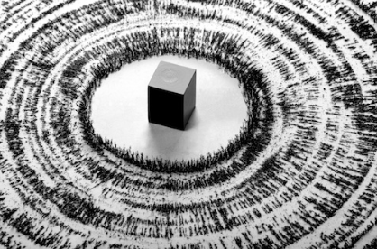
Magnetism
Chapter 10 Section 1

Slide 2
History of Magnetism
More than 2,000 years ago, the Greeks discovered deposits of a mineral that was a natural magnet.
They noticed that chunks of this mineral could attract pieces of iron.
This mineral was found in a region of Turkey that was known as Magnesia, so the Greeks called the mineral magnetic stone.
This mineral is now called magnetite.

Slide 3
History of Magnets cont.
Since the discovery of magnetite, many devices have been developed that rely on magnets
In the 12th century, Chinese sailors used magnetite to make compasses that improved navigation
In science, magnetism refers to the properties and interactions of magnets

Slide 4
Magnetic Force
If you’ve played with magnets before, you may have noticed that two magnets exert forces on each other
Depending on which ends of the magnets are close together, the magnets either repel or attract each other
You can notice the interaction between two magnets can be felt even before the magnets touch
The strength of the force between the two magnets increases as they move closer together

Slide 5
Magnetic Fields
A magnet can exert a force on a distant object because of its magnetic field
A magnetic field is a region of space that surrounds a magnet and exerts a force on other magnets and objects made of magnetic materials
The stronger the magnet, the stronger the magnetic field

Slide 6
Uses of Magnetic Fields/Why is this Important?
Magnetic fields are used in medical testing, specifically MRIs (Magnetic Resonance Imaging)
MRIs are noninvasive ways for doctors to examine your organs, tissues, and skeletal systems
The magnetic field in an MRI temporarily realigns hydrogen atoms in your body
Radio waves align the atoms to produce faint signals, which are used to create images the doctors use to diagnose problems

Slide 7
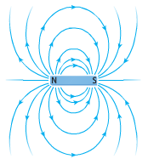
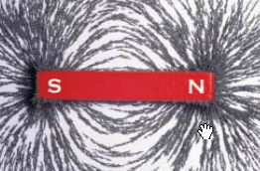
Magnetic Field Lines
The magnetic field can be represented by lines of force called magnetic field lines
The closer together the magnetic field lines are, the stronger the magnetic field is at that point.

Slide 8
Magnetic Poles
Magnetic fields are the strongest at the ends
The regions that exert the strongest force are called magnetic poles
All magnets have a north and south pole, for a bar magnet these are on opposite ends

Slide 9
How Magnetic Poles Interact
Whether two magnets attract or repel each other depends on which poles are brought close together.
Two north poles or two south poles repel each other
A north pole and a south pole always attract each other
Like repels & opposite attracts

Slide 10
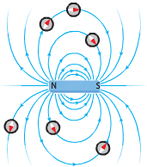
Magnetic Field Direction
Magnetic fields also have a direction
Magnetic fields always point away from north magnetic poles and toward south magnetic poles

Slide 11
Magnetic Fields and Compasses
When a compass needle is brought near a bar magnet, the compass needle rotates.
A compass needle is a small bar magnet with a north pole and a south pole
The north pole of a compass points in the direction of a magnetic field

Slide 12
Earth’s Magnetic Field
A compass can help determine direction because the needle’s north pole points to a location near Earth’s geographic north pole
Earth’s geographic north pole is the northernmost point on Earth
Earth acts like a giant bar magnet with a magnetic field that extends into space
Earth’s magnetic field is not very strong
A refrigerator magnet is about 100 times stronger than Earth’s magnetic field

Slide 13
Earth’s Magnetic Poles
The north pole of a magnet is defined as the end of the magnet that points toward Earth’s geographic north pole
Sometimes the poles of a magnet are called the north-seeking pole and the south-seeking pole
Opposite magnetic poles attract, so the north pole of a compass needle is attracted to the south magnetic pole
This means Earth’s south magnetic pole is near its geographic north pole

Slide 14
Earth’s Magnetic Fields

Slide 15
Magnetic Materials
Magnets will not attract all metal objects
What makes an element magnetic?
Remember all atoms contain electrons
Electrons have magnetic properties
In most elements, the magnetic properties of the electrons cancel out
In magnetic elements, these magnetic properties don’t cancel out and each atom behaves like a small magnet with its own magnetic field and north/south poles

Slide 16
Magnetic Domains
In magnetic materials, such as iron, the magnetic field created by each atom exerts a force on other nearby atoms.
These forces cause large groups of neighboring atoms to align
These groups with aligned magnetic poles are called magnetic domains
A permanent magnet is any material whose domains remain aligned without an external field.

Slide 17
Magnetic Domains

Slide 18
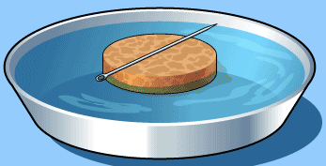
CYO Compass Mini-Lab

Slide 19
Wrap Up

